Slide 1
Ministry of Energy and Energy Industries Republic of Trinidad and Tobago
And the Gas Exporting Countries Forum
GAS SYMPOSIUM

Slide 2
Trinidad and Tobago and Natural Gas

Slide 3
2017 Average Total Consumption:
25 mmscfd
252 mmscfd
2017 Average Total Production:
3356 mmscfd
1047 mmscfd
8 mmscfd
117 mmscfd
1728 mmscfd

Slide 4
Evolution of the Market

Slide 5
Table 1: Comparison of LNG markets then and now
 | THEN | NOW
Marketing | Long term contracts | More spot trading
Financing | Only 1P reserves financed | Even 2P reserves can get financing
Technology and Infrastructure | Limited ability to monitor and verify cargoes Limited to regasification terminals | Real time cargo tracking Developments in small scale LNG, floating LNG units

Slide 6
Challenges
Losses in Value

Slide 7
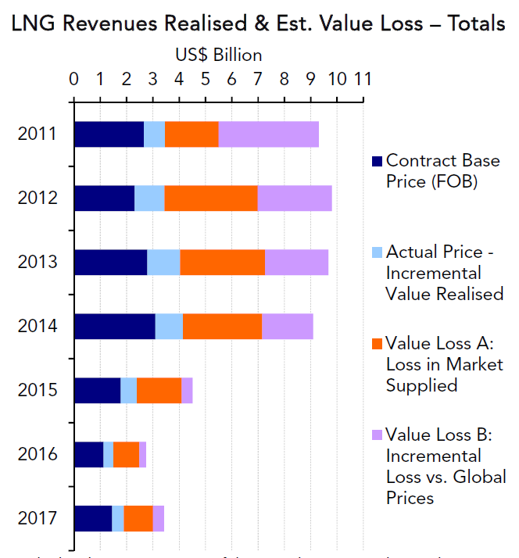
Value Loss A:
Difference between the price realized from the market actually supplied and Poten’s estimate of the prevailing price in that market
Value Loss B:
Poten’s estimate of the incremental price that could have potentially been realized by selling FOB at an oil-linked price (11.5 – 12%)
(Poten & Partners Spotlight on Energy presentation, March 2018)

Slide 8
Looking Ahead
Dragon Gas Deal

Slide 9
Dragon field gas reserves: 2.4 tcf
Expected production: 150 mmscfd
Gas to be transported to Hibiscus platform via 17km pipeline
Estimated pipeline project cost: US$1 billion

Slide 10
Looking ahead
Shallow Water Competitive Bid Round 2018

Slide 11
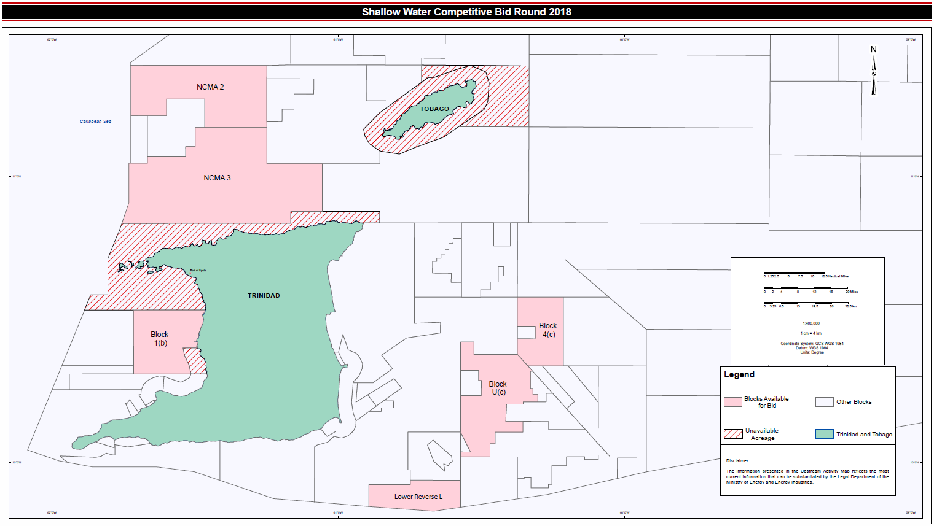

Slide 12
Planned Upstream Activities

Slide 13
US$10 billion over the next 5 years
2018 Drilling:
bpTT – 5 development wells
Shell – 7 development wells
BHP – 3 exploration wells

Slide 14
Natural Gas and Long-Term Energy Security

Slide 15
Abundant reserves
New technologies for processing and transportation
Growing markets
BUT
Challenges with cost competitiveness, security of supply and sustainability
Changing market conditions

Slide 16
Thank you.

