Slide 1
The Role of the Natural Gas in the Energy Policies in LAC
Gas Symposium
Port of Spain, Trinidad and Tobago
Nov. 13, 2018
Alfonso Blanco
Executive Secretary

Slide 2
About OLADE
Intergovernmental public entity
Established on November 2, 1973
27 countries of the Latin American and Caribbean Region
Purpose
Contribute to the economic and social development of the Latin American and Caribbean countries supporting:
Regional Energy Integration
Protection and conservation of energy resources
Rational use of energy
http://www.olade.org/

Slide 3
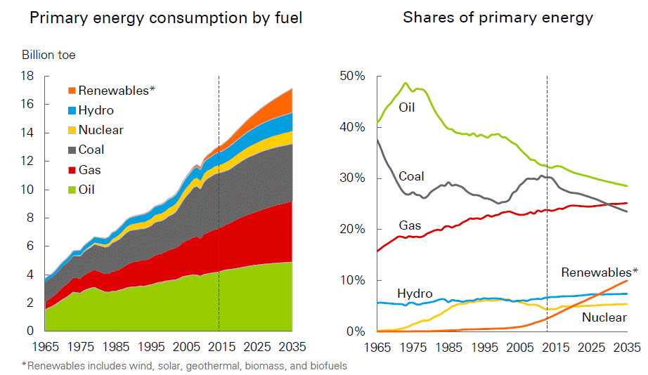
Global Trends: Primary Energy consumption
Increase in the share of renewables and natural gas (shale), decrease in the consumption of coal and oil
The increase of NG in LAC energy matrix will be motivated for the use of NG in power generation.
Source: Based on Outlooks. IEA, EIA, BP, ExxonMobil, CNPC, MIT, IEEJ, IHS, PIRA.
The various prospective studies are consistent with the fact that renewables and natural gas will be drivers of primary energy consumption.

Slide 4
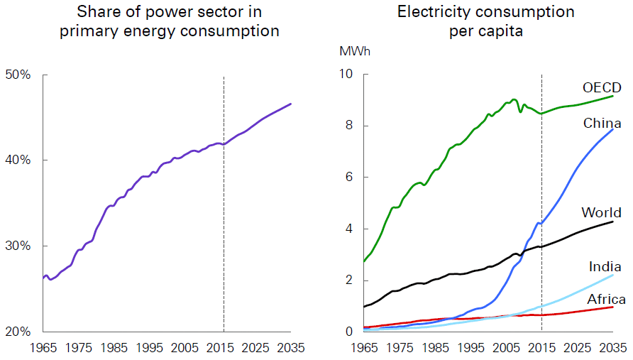
Global Trends: Increase the electricity share
Source : Based on Outlooks. IEA, EIA, BP, ExxonMobil, CNPC
The share of power sector in primary energy consumption would increase from 42% in 2015 to 47% in 2035.

Slide 5
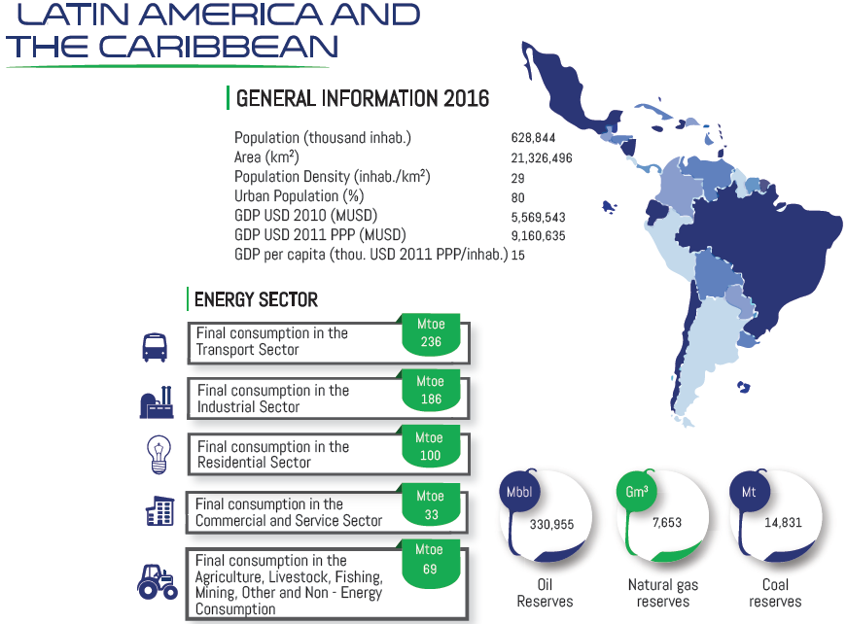
LAC General features
Source: OLADE – Energy Statistics Yearbook 2017, http://sielac.olade.org

Slide 6
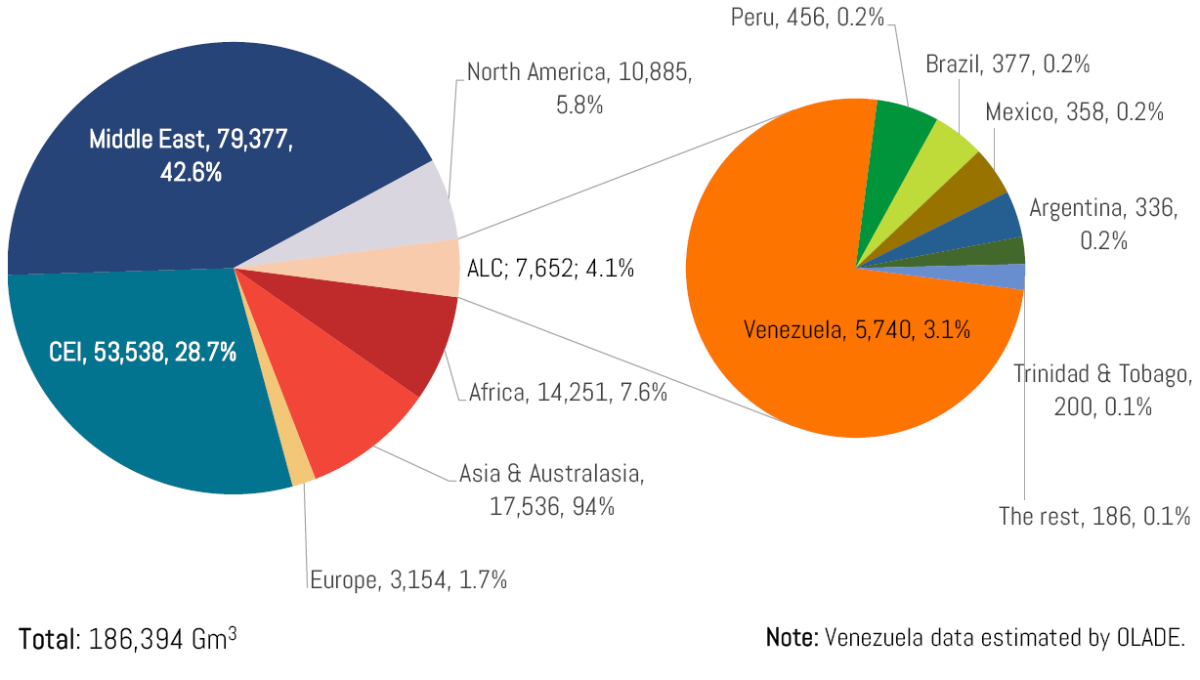
World proven natural gas reserves [Gm³, %]
Source: OLADE – Energy Statistics Yearbook 2017, http://sielac.olade.org
Note: It does not include Shale Gas

Slide 7
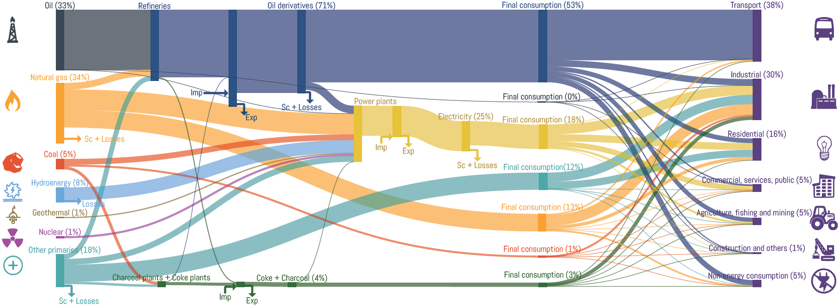
Energy Balance LAC 2016
Total supply of primary energy
816 Mtoe
Total supply of secondary energy
536 Mtoe
Total final consumption
624 Mtoe
Source: OLADE – Energy Statistics Yearbook 2017, http://sielac.olade.org

Slide 8
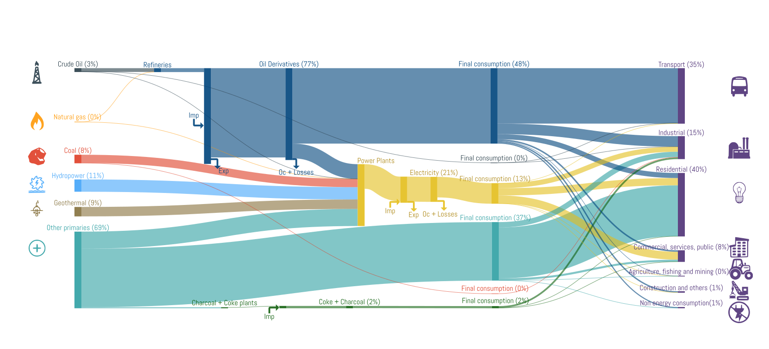
Energy Balance Central America 2016
Total supply of primary energy
20.71 Mtoe
Total supply of secondary energy
22.25 Mtoe
Total final consumption
29.36 Mtoe
Source: OLADE – Energy Statistics Yearbook 2017, http://sielac.olade.org

Slide 9
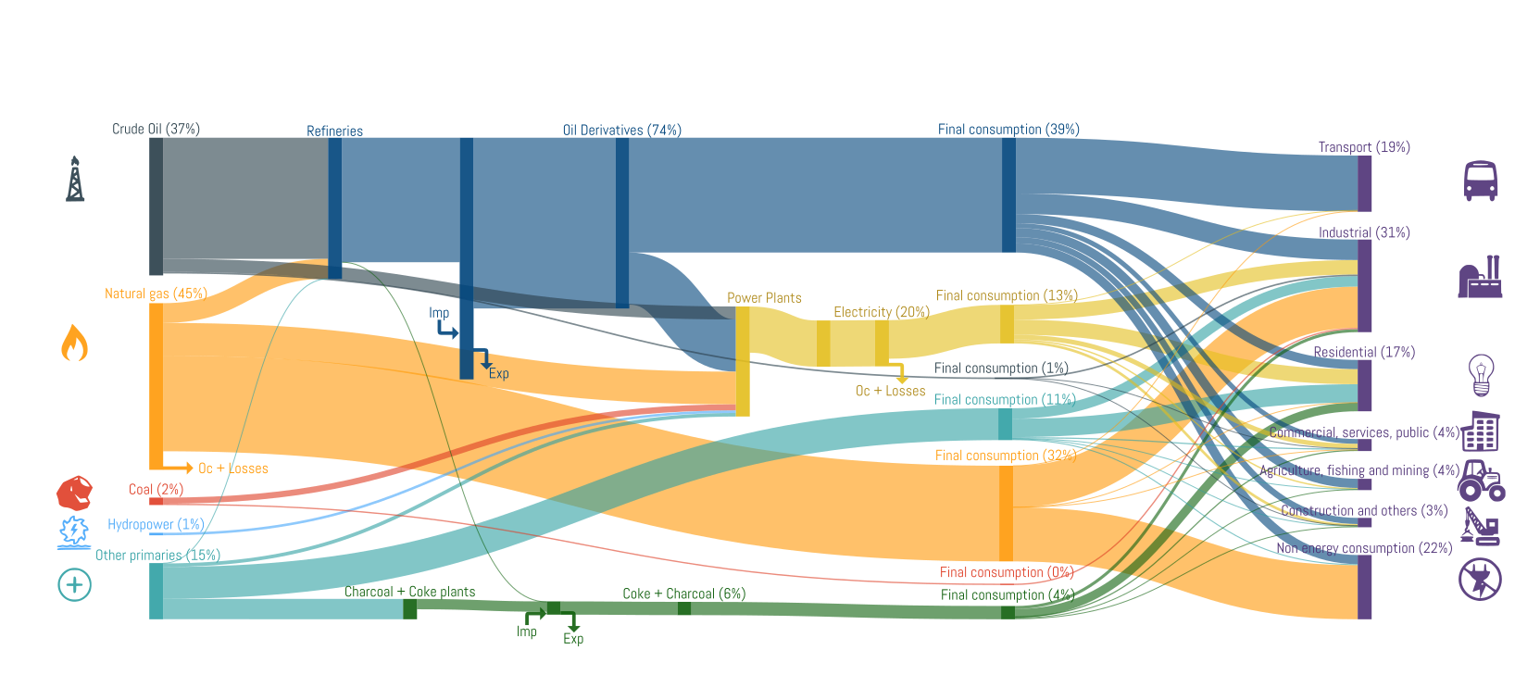
Energy Balance Caribbean 2016
Total supply of primary energy
41.28 Mtoe
Total supply of secondary energy
25.48 Mtoe
Total final consumption
33.11 Mtoe
Source: OLADE – Energy Statistics Yearbook 2017, http://sielac.olade.org

Slide 10
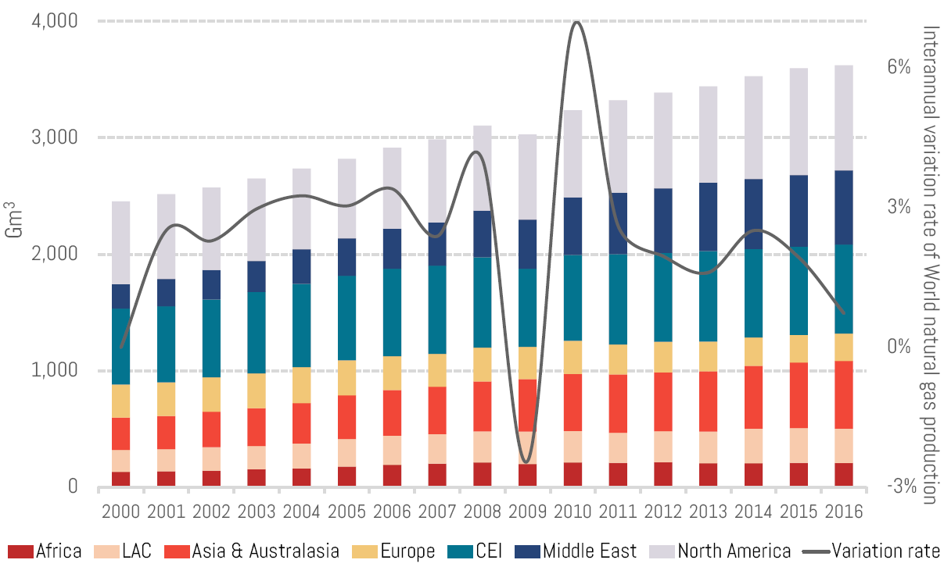
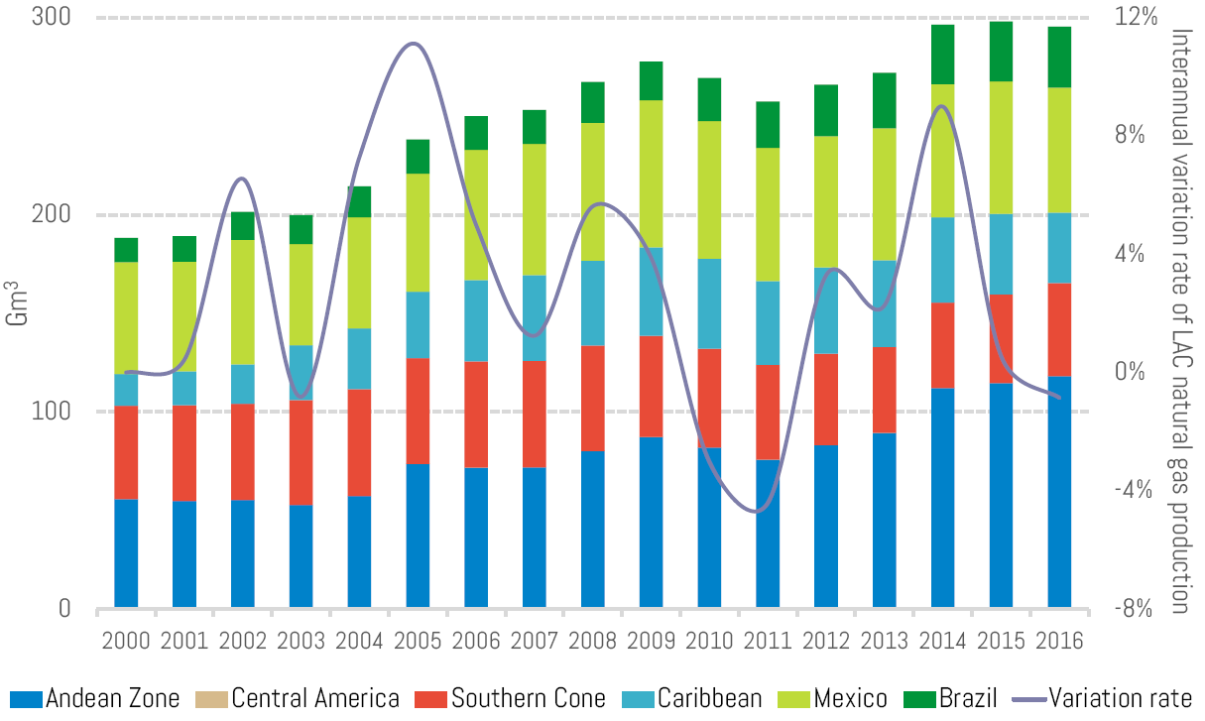
World and LAC natural gas production
World by region
LAC by subregion
Source: OLADE – Energy Statistics Yearbook 2017, http://sielac.olade.org

Slide 11
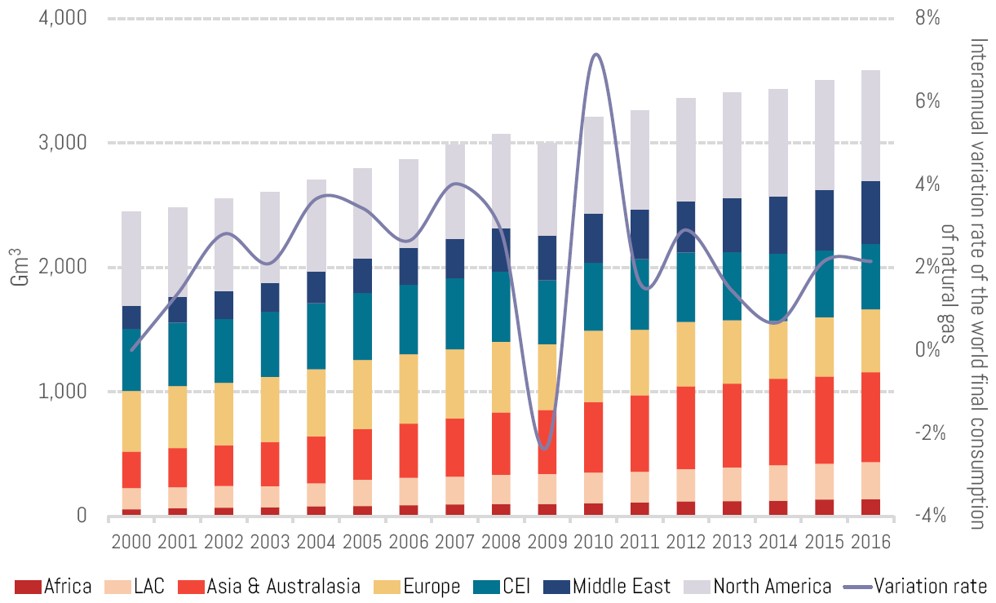
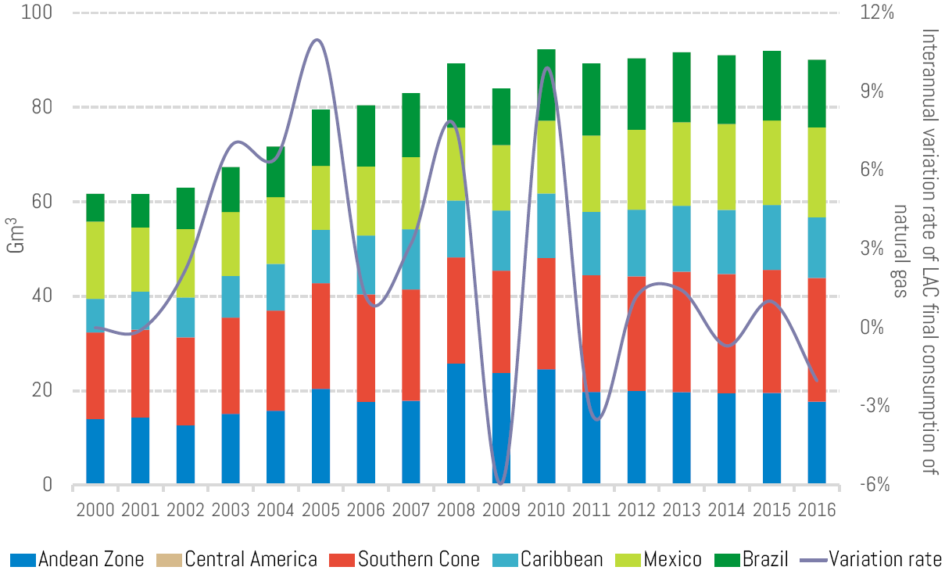
World and LAC natural gas consumption
World by region
LAC by subregion
Source: OLADE – Energy Statistics Yearbook 2017, http://sielac.olade.org

Slide 12
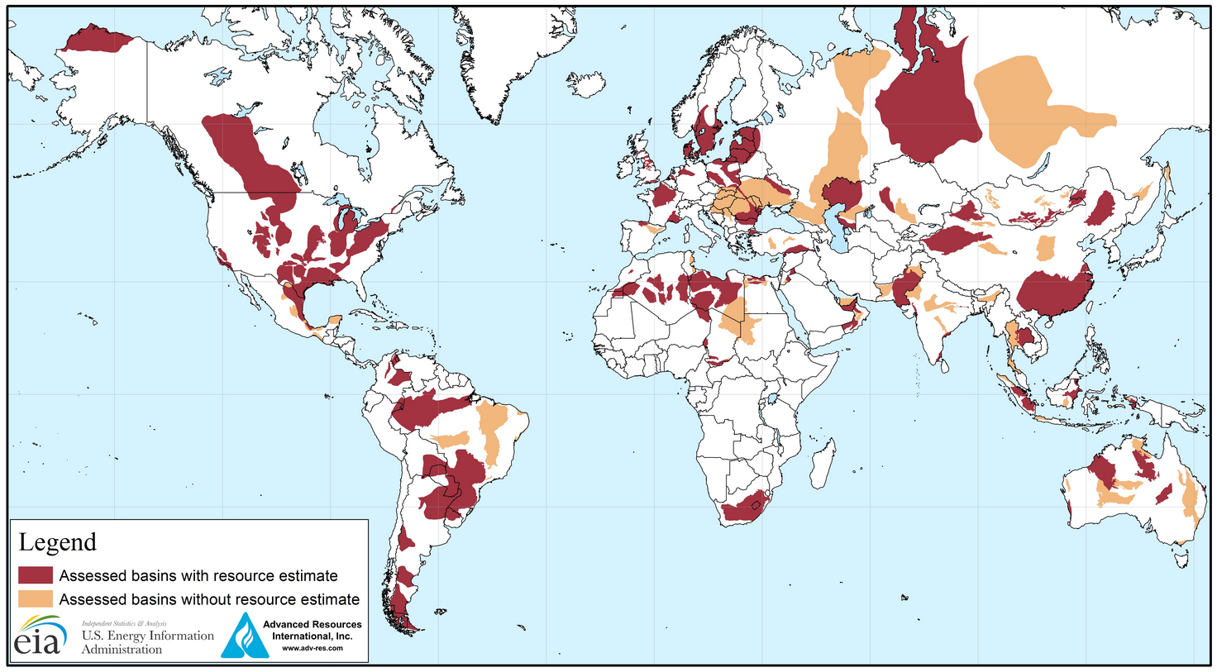
Shale oil and Shale gas fields
Source: https://www.eia.gov/analysis/studies/worldshalegas/

Slide 13
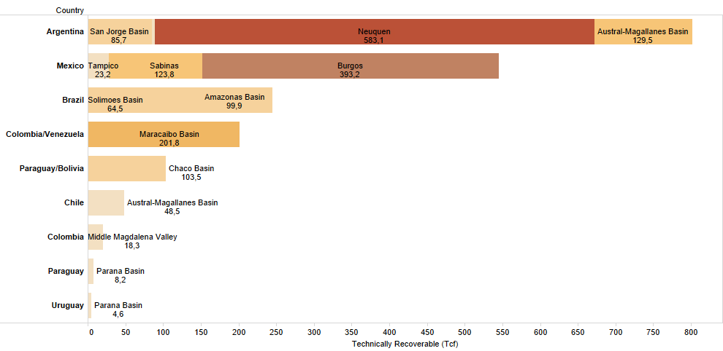
Technically recoverable Shale Gas resources in LAC
Source: https://www.eia.gov/analysis/studies/worldshalegas/

Slide 14
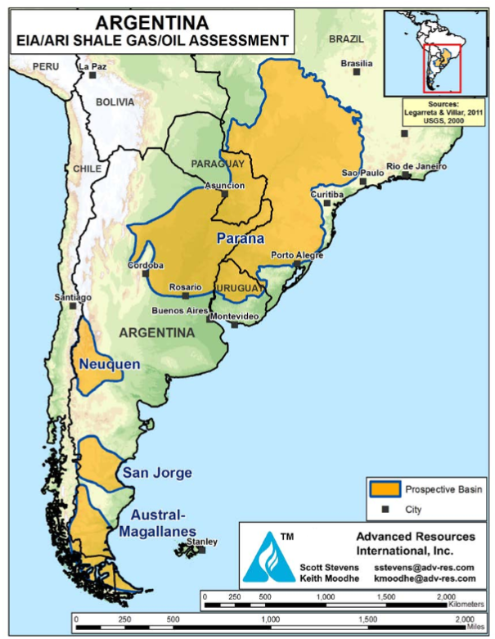
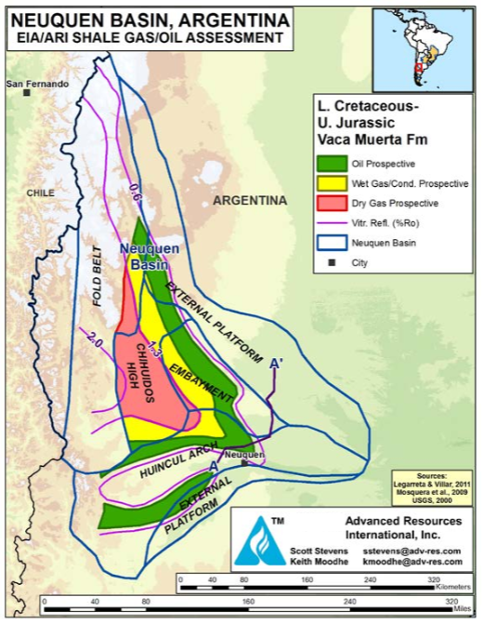
Prospective Shale Basins in Argentina
Prospective Shale Basins of Argentina
Vaca Muerta Shale Gas and Shale Oil Prospective Areas
Second largest non-conventional resource reservoir in the world, with an estimated potential of 583 trillion cubic feet of gas.
The province has 27 areas with non-conventional exploitation permits where Shale and Tight projects are developed.
The Province of Neuquén has 82,500 km² (87% of its surface area) for the exploration and exploitation of Hydrocarbons.
Source: https://www.eia.gov/analysis/studies/worldshalegas/archive/2013/pdf/fullreport_2013.pdf

Slide 15
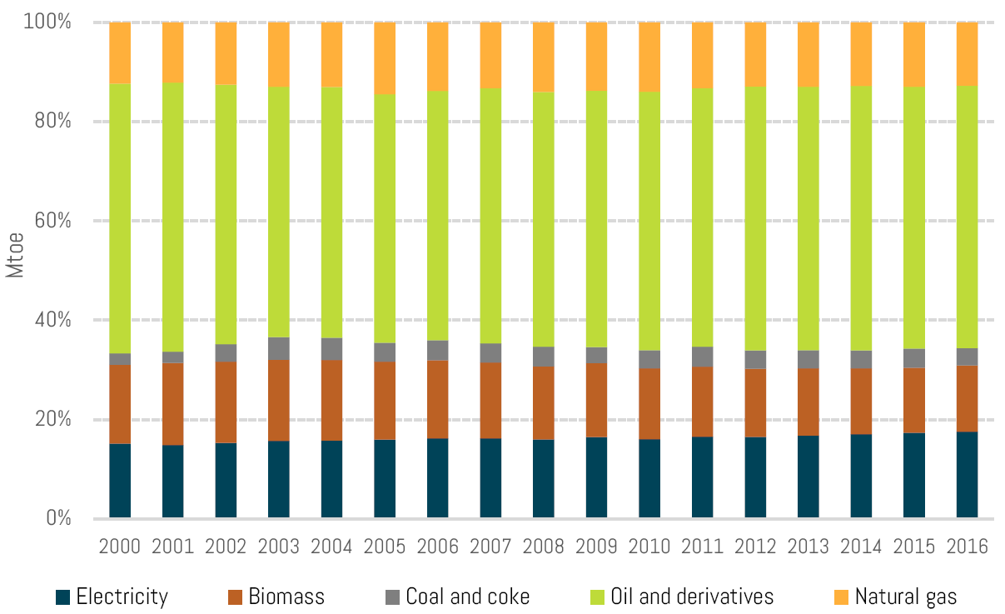
LAC Energy final consumption by energy source
Source: OLADE – Energy Statistics Yearbook 2017, http://sielac.olade.org

Slide 16
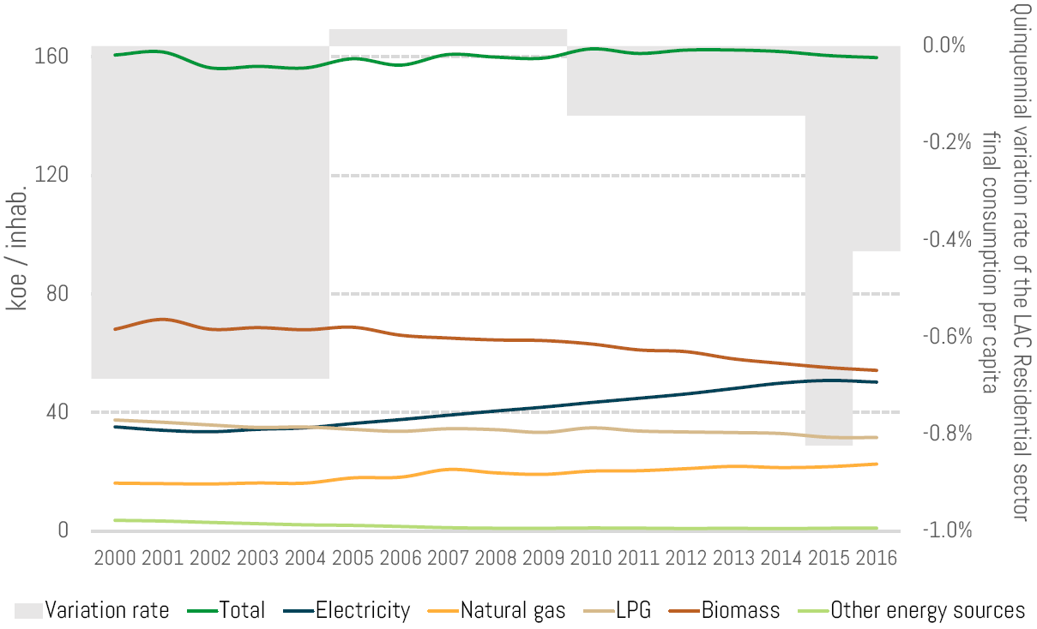
LAC Household sector final consumption per capita
Source: OLADE – Energy Statistics Yearbook 2017, http://sielac.olade.org

Slide 17
Imports / Exports LNG in LAC 2016
Source: BP, Statistical Review of World Energy, 2017.

Slide 18
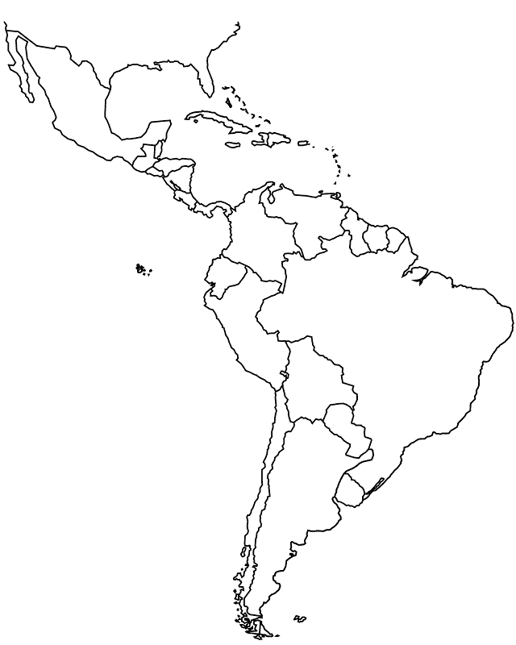
LNG Trade in LAC 2016
Canadá
Europa & Eurasia
Este Medio
África
Asia Pacífico
USA
Argelia
Guinea Ecuatorial
Nigeria
Australia
Indonesia
México
Noruega
Otros Europa
Qatar
Angola
Guinea Ecuatorial
Nigeria
Trinidad & Tobago
Asia Pacífico
Europa & Eurasia
Asia Pacífico
Perú
Brasil
Noruega
Otros Europa
Qatar
Guinea Ecuatorial
Chile
Noruega
Otros Europa
Qatar
Argelia
Guinea Ecuatorial
Nigeria
Australia
Argentina
Source: BP, Statistical Review of World Energy, 2017.

Slide 19
LNG Trade Volumes 1990 – 2016
Source: IGU World LNG Report — 2017 Edition

Slide 20
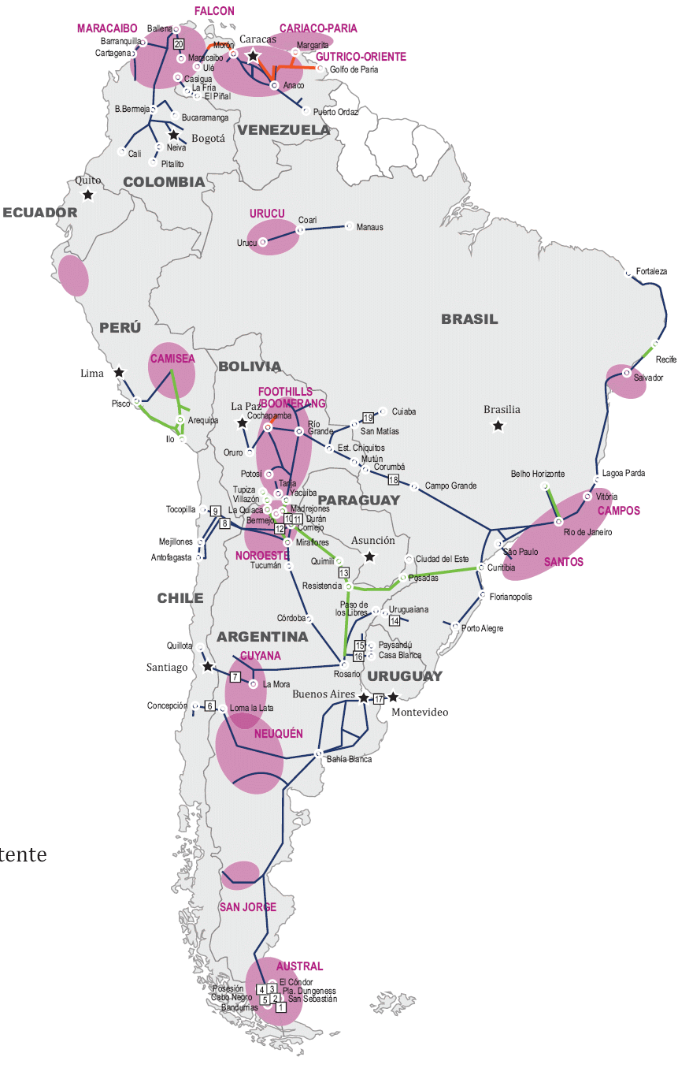
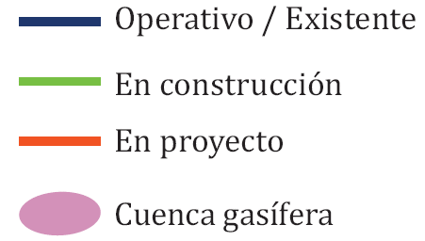
Natural Gas Interconnections
Operative/Existent
Under construction
Under Project
Gas basin
Source: Bilateral agreements supporting energy interconnections in South America, Griselda Lambertini, ENERLAC, Vol. 1, No. 1. 1,2017, OLADE.

Slide 21
The Role of Natural Gas in Energy Policies of LAC
The Natural Gas (NG) in the past has had an important participation in the energy matrix of some countries of LAC (Argentina, Colombia and Mexico)
The participation of the NG will increase in the future replacing the power generation from liquid fuels.
The LNG is presented as a valid alternative for the substitution of source in power generation.
While there are multiple initiatives aimed at increasing the capacity of LNG in the region, there are few regional interconnection projects through gas pipelines.
Lack of regional markets for GN. The exchanges are made under bilateral agreements.
NG is an alternative to reduce the GHG emissions in the region.
There are important opportunities for the substitution of liquid fuels in transport sector by NG.
The NG is a valid, efficient and competitive alternative for the thermal backup required by renewable energies. Renewable energies can be complementary to the development of natural gas in the region.
Central America and the Caribbean have important potential for the substitution of liquid fuels by NG, the small-scale LNG is seen as the feasible alternative.
Argentina and Chile will start exchanges of GN based on recent political agreements.

Slide 22
The Role of Natural Gas in Energy Policies of LAC
North America and Mexico have developed dynamic and integrated NG markets in last five years. The sectoral reform in Mexico has had important impact.
The reserves of shale gas in Argentina will modify the regional market in the medium term and would turn Argentina into a potential NG exporter, however the potential problems associated with the seasonality of the demand in the Argentinean market result in a barrier to be solved to make feasible the non-conventional projects in Vaca Muerta.
Colombia, Brazil and Mexico are the other countries of the region with important unconventional reserves, however the stage of development is still primary.
Market and geography restrictions of some producers constitute significant problems in the medium term. The absence of regional markets for GN limits development. The need of regional reference prices for the NG markets.
Even when there are projects of incorporation of GN into the matrix of the countries, progress in policies and regulations for the subsector is reduced in most of the LAC countries.
Producers are those that have mature regulatory frameworks. But there is a lack of harmonized policies and regulatory frameworks for NG in the region.

Slide 23
INTEGRATION AND REGIONAL MARKETS
SUB REGIONAL STRATEGIES
…
LONG TERM POLICIES
INSTITUTIONAL AND LEGAL FRAMEWORKS

Slide 24
Thank you
Alfonso Blanco
Executive Secretary

