Slide 1
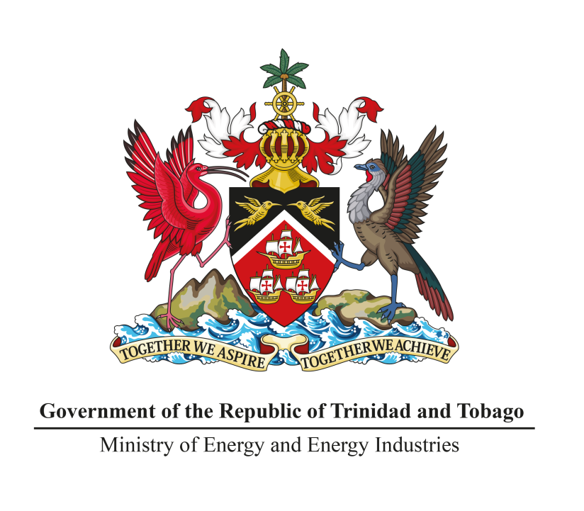
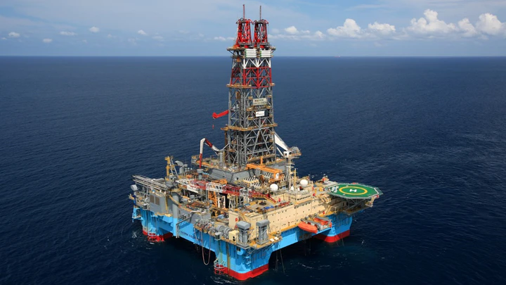
THE PRESENTATION OF THE RESULTS OF THE NSAI CRUDE OIL AUDIT FOR YEAR END 2018
Minister of Energy
5th August, 2020

Slide 2
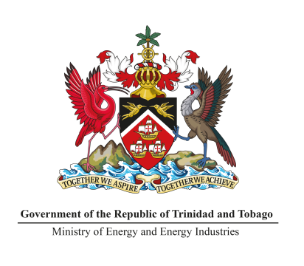
SLIDE 1
Reserves and Resource changes
Unrisked Category | 1/1/2012 (MMbbl) | 31/12/2018 (MMbbl) | Change 2012 to 2018 (MMbbl) | Comments
Proven Reserves | 199.5 | 220.1 | 20.6 | Increase by 10.3%
Probable Reserves | 85.5 | 99.7 | 14.2 | Increase by 16.6%
Possible Reserves | 124.8 | 135.5 | 10.7 | Increase by 8.5%
Contingent Resources (Best Estimate) | 58.0 | 68.0 | 10.0 | Increase by 17.2%
Prospective Resources (Best Estimate) | 368.2 | 3216.0 | 2847.8 | Increase by 773.4%

Slide 3
Proved Reserve changes by area
SLIDE 2
PROVED RESERVES AT 1/1/2012 BY AREA
PROVED RESERVES AT 31/12/2018 BY AREA

Slide 4
Recent Exploration and Development Achievements
SLIDE 3
BHP’s Block 3a Ruby field approval will add 15,000 bopd in 2022,
Trinmar’s addition of the Mobile Offshore Production and Compression Unit (MOPU) to add approximately 1,840 bopd for 2019/2020.
The Coho and Cascadura discoveries made in the Ortoire Block operated by Touchstone.
The Barakat discovery was made in the Rio Claro Block operated by Lease Operators Limited
The Saffron oil discovery was made by Columbus Energy in April.
The 2020 DeepWater Nomination Period is almost completed.

