Slide 1
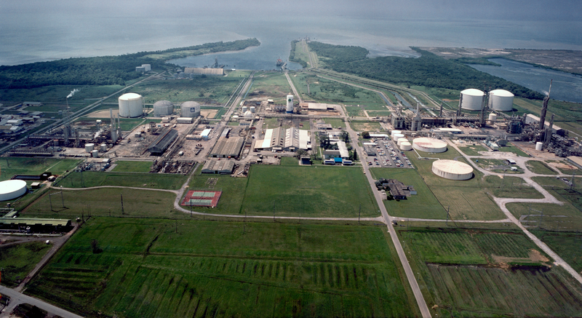
cARBON CAPTURE, UTILISATION & STORAGE A Trinidad & Tobago update 2024 Penelope Bradshaw –Niles Permanent Secretary, Ministry of Energy and Energy Industries
Government of the Republic of Trinidad and Tobago
Ministry of Energy and Energy Industries
TRINIDAD & TOBAGO ENERGY CONFERENCE
JANUARY 22-24, 2024
Juniper Platform
Source : bp

Slide 2
Carbon Capture & CO2 EOR Steering Committee Organization
Steering Committee Core Members:
Penelope Bradshaw-Niles – PS, Ministry of Energy and Energy Industries/ Chair
Kishan Kumarsingh – MoPD
Himalaya Boodoosingh - NGC
Erik Keskula– Heritage
Dr. Hasley Vincent- UWI
Sulana Chunilal- ALNG
Christian Welsh- MEEI
Steering Committee Coordinator
Yatindranath Keith Bally
Support –Lorez des Vignes
Prof Raffie Hosein –UWI
Dr. David Alexander- UTT
Lidia Ramlakan- Heritage
Himalaya Boodoosingh
Christian Welsh
Workgroup Group 1 SPA*
Workgroup Group 2 SPA
Workgroup Group 3 SPA
Workgroup Group 4 SPA
Workgroup Group 5
Technical/Subsurface
Heritage
MEEI
Carbon Atlas
UWI
UTT
MEEI
Basin Operators
GHG Emissions-
Methane
Heritage
MEEI
ALNG
NGC
Pt Lisas plants
Legal /Regulatory
Min of Planning
MEEI
EMA
Funding/Commercial
Min of Planning
Min of Finance
MEEI
Heritage
*Single Point of Authority

Slide 3
CABINET APPOINTED CCS/EOR Steering Committee
AIM: “To manage the implementation of a Large-Scale CO₂ EOR Project to increase T&T’s oil revenue and to address the reduction of CO₂ emissions”
Paris Agreement (2018): reduce GHG emissions by 15% before 2030
5 Working Groups:
CO₂ EOR – HPCL/MEEI
Identification of Onshore Reservoirs for CO₂ EOR (Completed)
Carbon Atlas – UWI/UTT
Quantification of Reservoirs for CO₂ Storage (Completed)
Policy/Legal – MEEI
Development of Framework and Legislation
Funding
GHG Methane Emissions – NGC
Strategies to Reduce Methane Emissions
Regulatory
Industry
Academia
University of the West Indies (UWI)
University of Trinidad & Tobago (UTT)
Heritage Petroleum Company Limited (HPCL)
National Gas Company (NGC)
Ministry of Energy & Energy Industries (MEEI)

Slide 4
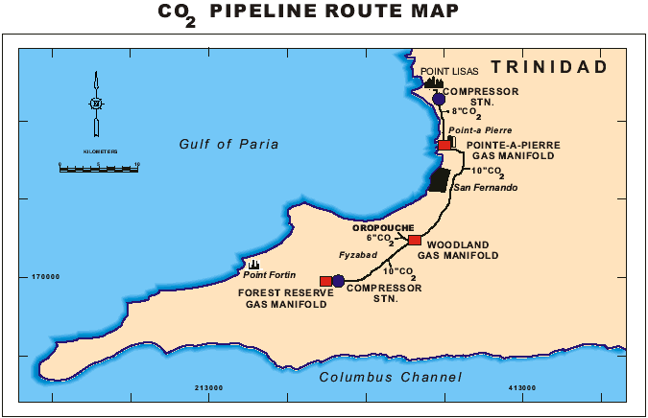
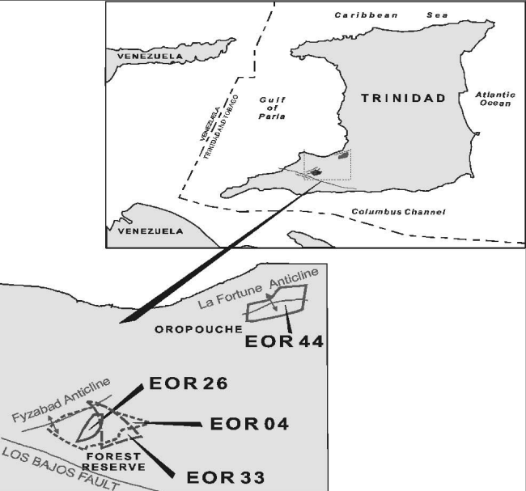
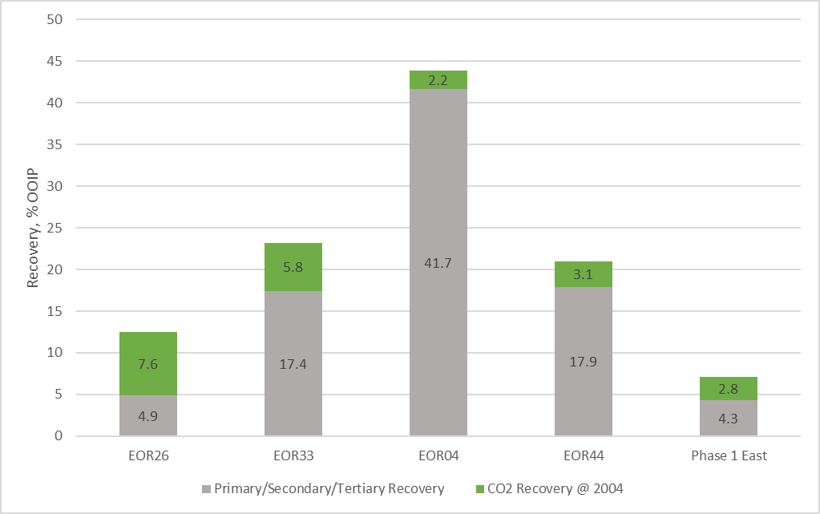
History of CO₂ ProjecTS in TRINIDAD
PHASE 1 EAST
Range of recovery within worldwide immiscible projects: 5-10%

Slide 5
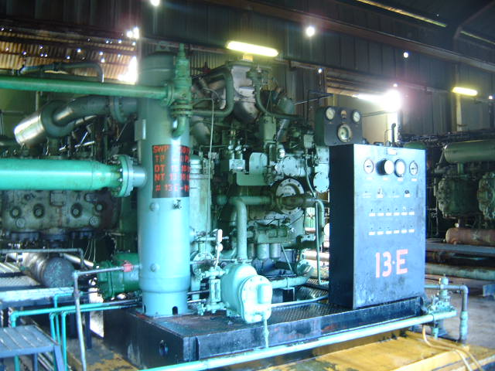
FoRMER CO₂ Distribution network
6.63 ml (8”)
1320’ (16”)
HydroAgri
1320’ (16”)
Petrotrin
Pt. Lisas )
P-a-P
9.5 ml (10”)
Woodland
8.4 ml (10”)
Forest
Reserve
12” gasoline
120 psig
0 psig
4 Compressors Rating (mmcfd)
1A CBGMXD-10 2.9
1B CBGMXD-10 2.9
1C WAUKESHA 7042 2.9
1D CBGMXD-10 2.9
- Glycol Dehydrator Unit (12-15 mmcfd)
X
4 Compressors Rating (mmcfd)
13C CBGMXD-10 5.8
13D CBGMXD-10 5.8
13E CBGMXD-10 4.2
13B CBGMXD-10 4.2
1.3 ml (6”)
Oropouche
250 psig
1000 psig
Cooper Bessemer CO₂ Compressor (circa 1950’s)

Slide 6
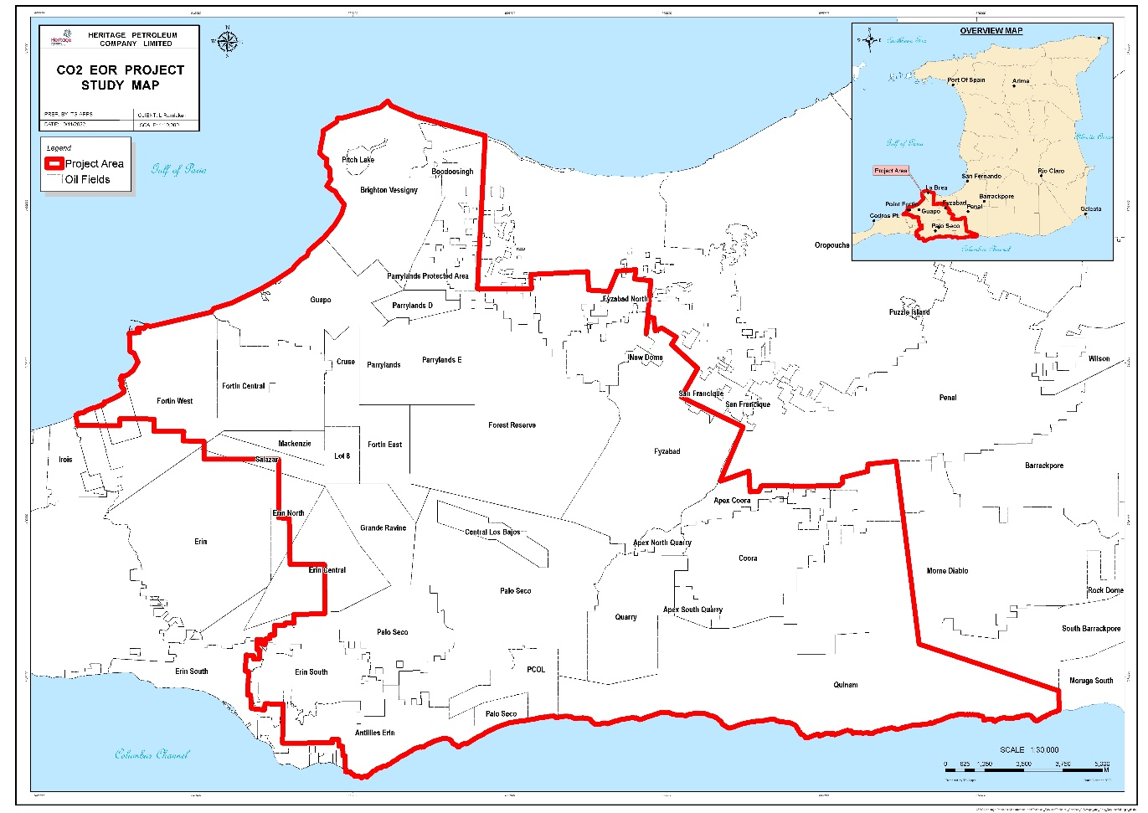
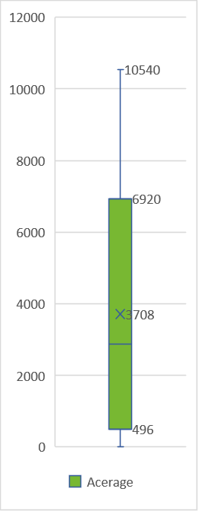
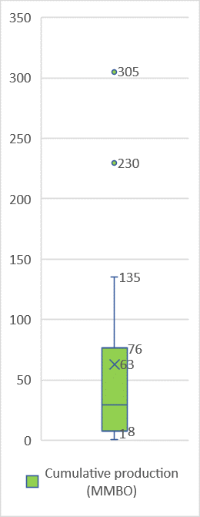
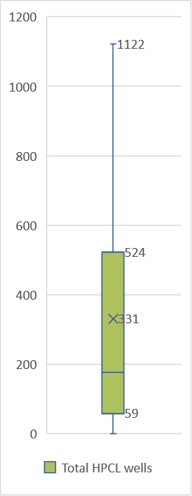
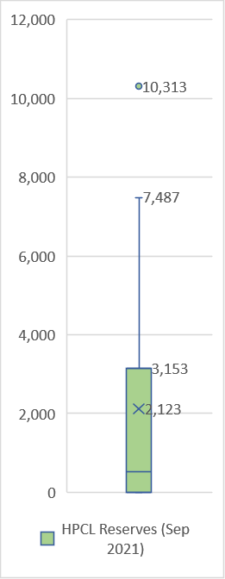
Study area for CO₂ EOR suitability
17 onshore fields
Apex Quarry North/South/Quarry, Boodoosingh, Brighton Vessigny, Central Los Bajos/Los Bajos, Coora/Apex Coora, Cruse, Erin, Forest Reserve, Fyzabad, Guapo, Mackenzie, Morne Diablo, New Dome, Palo Seco, Parrylands, Point Fortin, Quinam
Total acreage=
66,744 acres
Total cumulative production =
1.1 BBO
Total HPCL wells = 5,625
Total reserves =
36 MMBO

Slide 7
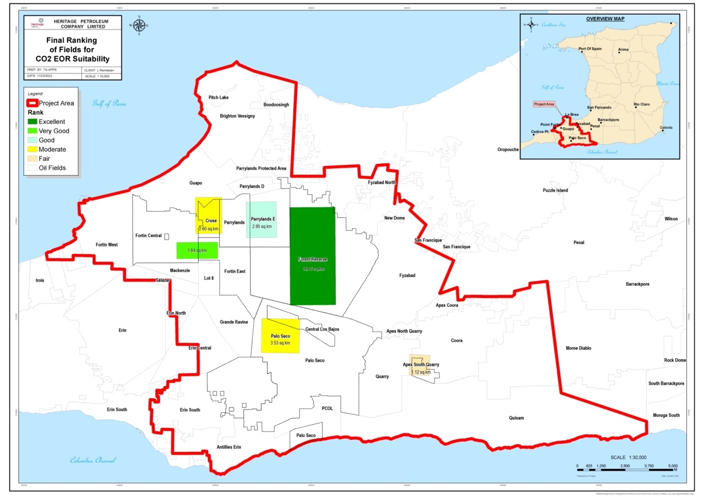
Inventory Screening and ranking results –
field selection
CO₂ EOR – HPCL/MEEI
Screened and ranked 17 fields based on:
Reservoir Properties - ɸ, k, S_{wi}, ºAPI, µ, etc.
Geological - Formation, Depth, Reservoir Continuity
Field Surface Features - Terrain, Infrastructure, Pipelines
Wells & Production - Acreage, Sub-Licenses, Active & Total Wells, Current & Cumulative Production, Reserves
FIELDS* | RATING
FOREST RESERVE | EXCELLENT
POINT FORTIN (CENTRAL, EAST & WEST) | VERY GOOD
PARRYLANDS (PL,D,E) | GOOD
CRUSE | MODERATE
APEX QUARRY NORTH, APEX QUARRY SOUTH / QUARRY | MODERATE
PALO SECO | MODERATE
Selected FR AOI has past/current success with EOR projects, favorable reservoir parameters and existing wells/surface facilities.
*Acreage with 100% HPCL operatorship
Notes:
It can be seen from the scores and ratings obtained that the Forest Reserve field is the best candidate for CO₂ EOR among the Onshore Western Fields. It is closely followed by Point Fortin and Parrylands respectively.

Slide 8
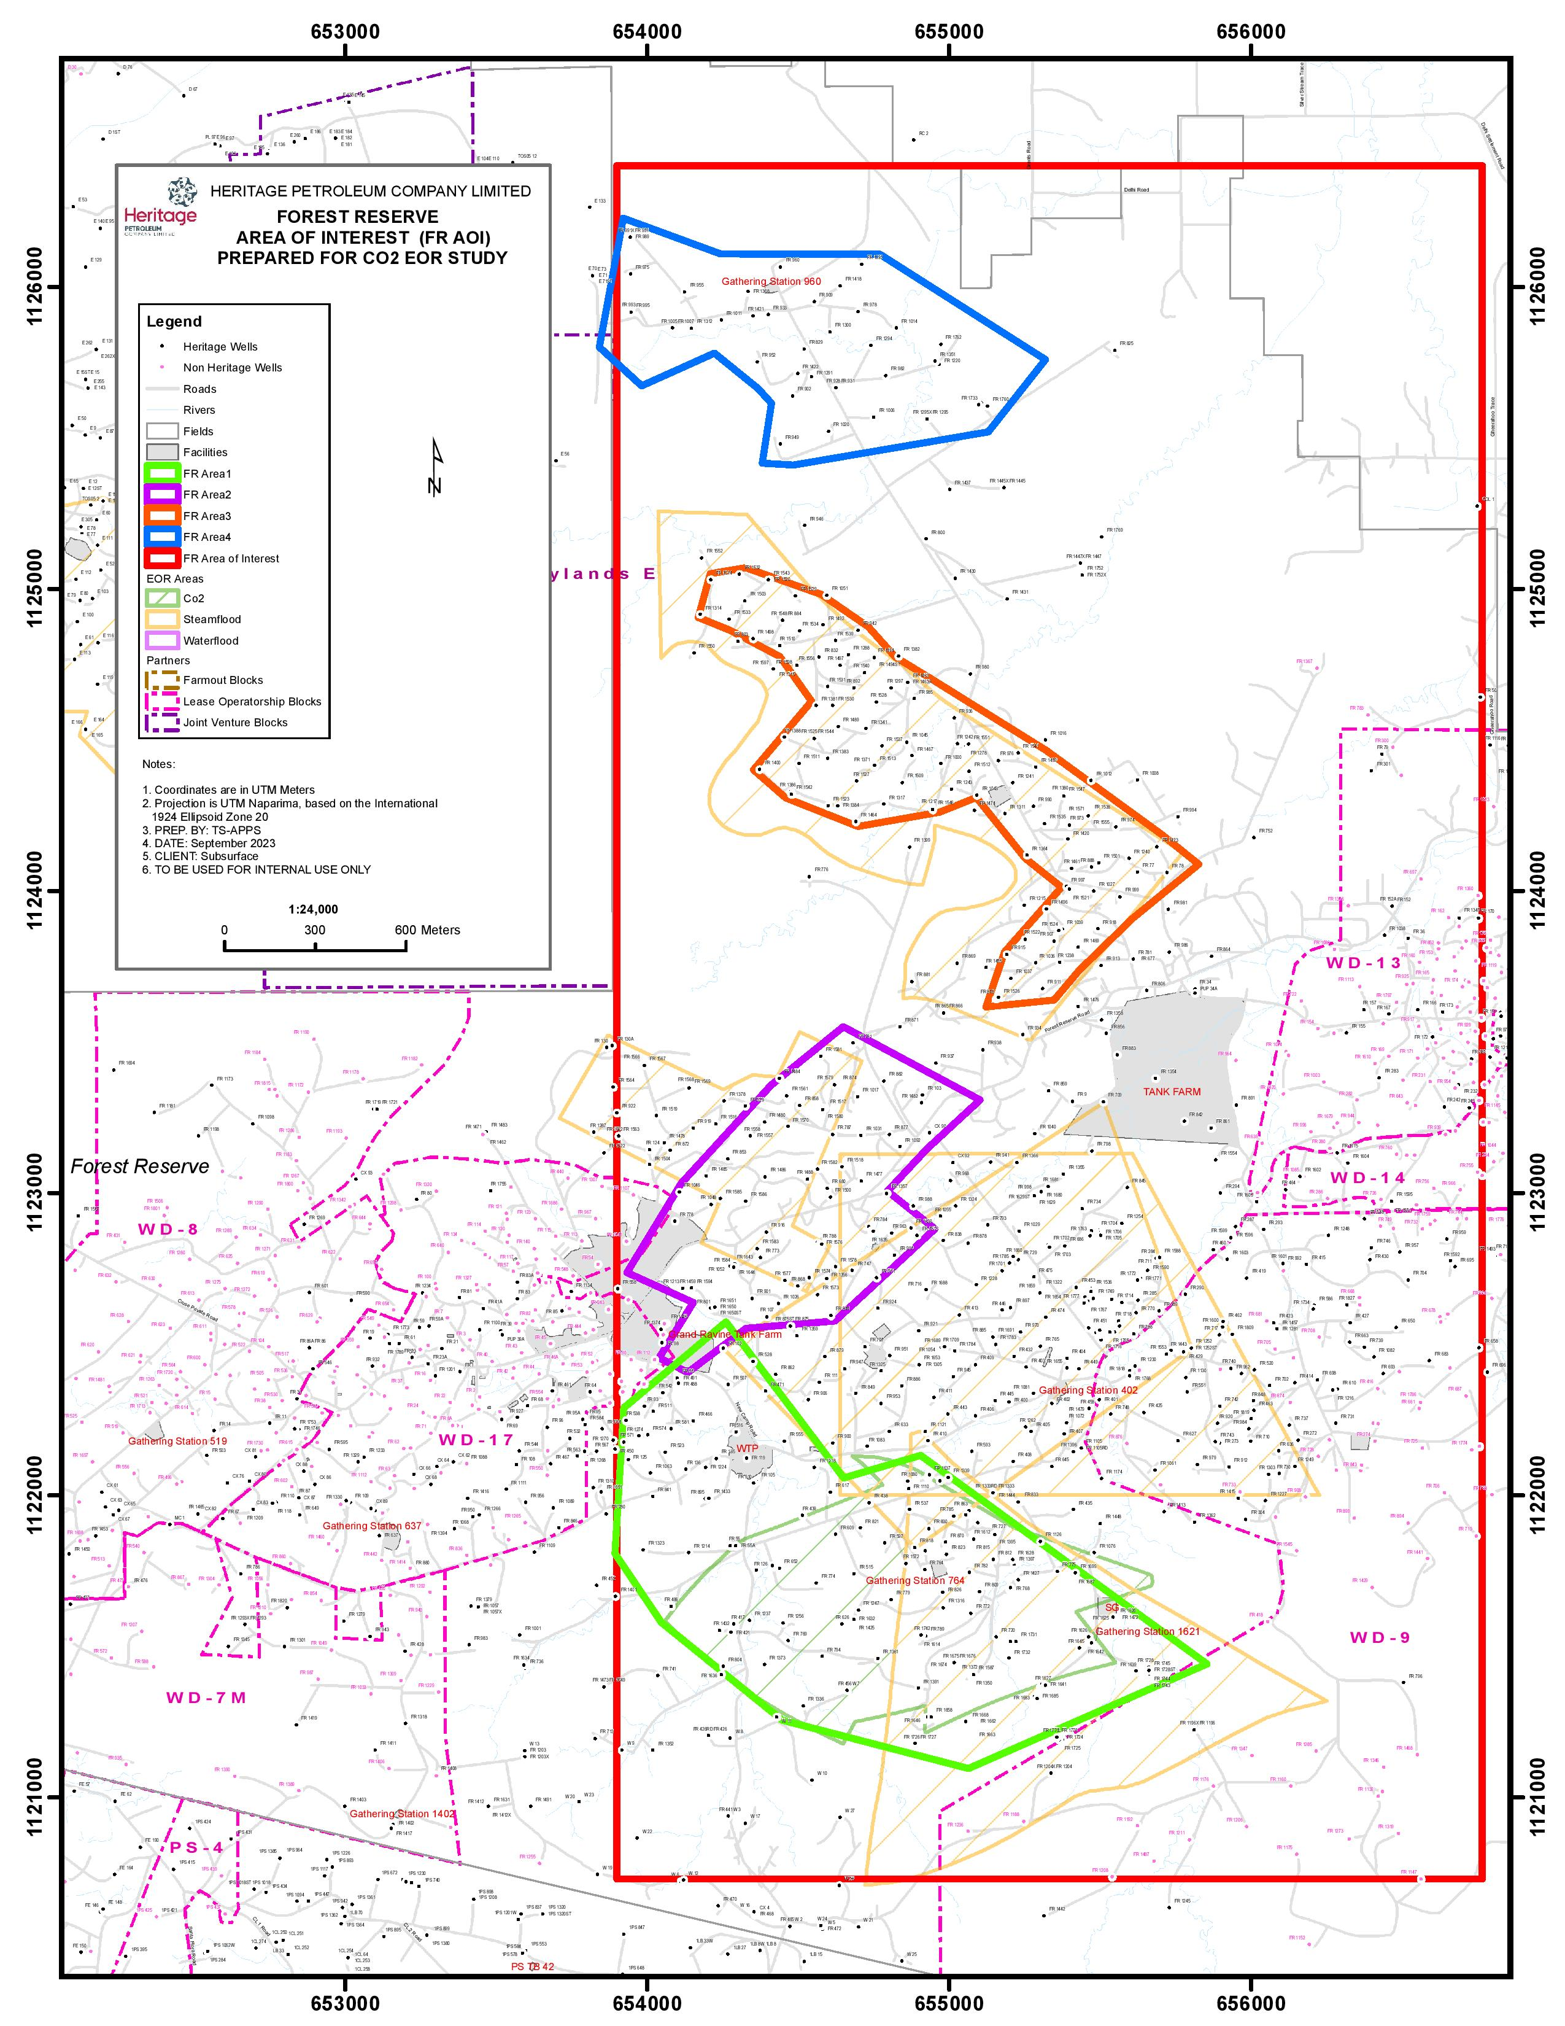
CO₂ EOR – HPCL/MEEI
FOREST RESERVE
AREA OF INTEREST
≈4000 acres
N
FR 1700
FR AREA 4
(FR1700/ PROJECT 21 – HWF)
RESERVOIRS: Cruse
DEPTH: 2000 ft TVDSS
TOTAL WELLS: 53
ACREAGE: 439 acres / 1.78 km²
FR AREA 2
(PHASE 1 EAST AND WEST
STEAMFLOOD/ CO₂ EOR)
RESERVOIR: Forest
DEPTH: 900 ft TVDSS
TOTAL WELLS: 85
ACREAGE: 243 acres/ 1 km²
FR AREA 3
(PROJECT 3- STEAMFLOOD)
RESERVOIR: Forest
DEPTH: 1000ft TVDSS
TOTAL WELLS: 143
ACREAGE: 573 acres / 2.32 km²
FR AREA 1
(EOR04, EOR33 CO₂)
RESERVOIRS: Forest, Cruse
DEPTH:1500 to 4500 ft TVDSS
TOTAL WELLS: 169
ACREAGE: 359 acres /1.45 km²

Slide 9
Terms of reference FEASIBILITY OF CO2 EOR in hpcl western fields
Build an analog on analyses of EOR04 and EOR33 for identified areas within Forest Reserve AOI and get estimates of:
Develop an appropriate scaling methodology that utilizes the outputs
Develop an overall project production forecast combining the results of all six AOI’s
Number/ Placement of required Injectors/Producers
Required CO2 injection volumes/rates
Forecast of Oil Production without CO2
CO2 Utilization (Mscf/bbl)
Incremental Oil Recovery from CO 2
Point Fortin (Central, East)
Parrylands (E)
Cruse
Palo Seco (NPS)
Apex Quarry N/S/Quarry (AQS)
Forest Reserve

Slide 10
5 Working Groups:
CO2 EOR – HPCL/MEEI
Identification of Onshore Reservoirs for CO₂ EOR (Completed)
Carbon Atlas – UWI/UTT
Quantification of Reservoirs for CO₂ Storage (Completed)
Policy/Legal – MEEI
Development of Framework and Legislation
Funding
GHG Methane Emissions – NGC
Strategies to Reduce Methane Emissions
AIM: “To manage the implementation of a Large-Scale CO₂ EOR Project to increase T&T’s oil revenue and to address the reduction of CO₂ emissions”
Paris Agreement (2018): reduce GHG emissions by 15% before 2030
Regulatory
Industry
Academia
University of the West Indies (UWI)
University of Trinidad & Tobago (UTT)
Heritage Petroleum Company Limited (HPCL)
National Gas Company (NGC)
Ministry of Energy & Energy Industries (MEEI)

Slide 11
key Highlights of Carbon storage atlas
The focus in this study was the offshore Soldados fields, and onshore Point Fortin, Guapo, Grand Ravine, Forest Reserve and Palo Seco fields all of which are in the Southern Basin and Blocks 1(a) and 1(b) in the Northern Basin.
The theoretical storage capacity was estimated to be 126.5 Mt, with the effective storage capacity being 92.1 Mt.

Slide 12
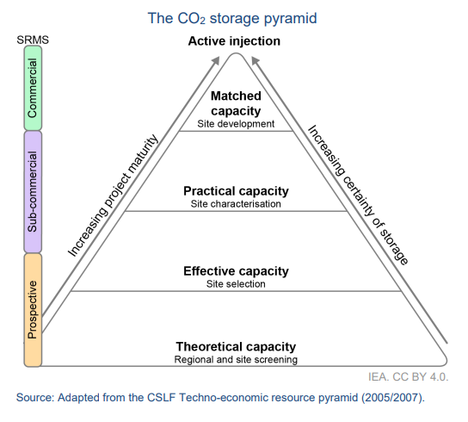
current work Carbon Atlas – UWI/UTT
Phase 1 Extension :CO2 Storage; Theoretical Volumetric Estimates
Theoretical and Effective Estimation of the storage capacities
Theoretical Storage Capacity: represents the maximum upper limit to a capacity estimate- the physical limit of what the geological system can accept. According to (Bradshaw et al, 2007) there are various possible interpretations of the physical limit:
Entire pore space
Only pore space from original resident fluids (gas, oil or water) that can be displaced.
Effective Storage Capacity: represents a subset of the theoretical storage capacity. It can be determined by applying a range of technical (geological and engineering) cut off limits to the storage capacity assessment, including consideration of the theoretical storage capacity that can be physically accessed (Bradshaw et al, 2007)

Slide 13
future work Carbon Atlas – UWI/UTT
Phase 2: CO2 EOR and CO2 Storage via Numerical Simulation Modeling
Theoretical and Effective Estimation of the storage capacities in saline aquifers
Reservoir modelling and detailed Simulation studies to determine oil production by CO2 injection and Estimation of CO2 storage volumes
Pilot Injection Well Project

Slide 14
5 Working Groups:
CO2 EOR – HPCL/MEEI
Identification of Onshore Reservoirs for CO₂ EOR (Completed)
Carbon Atlas – UWI/UTT
Quantification of Reservoirs for CO₂ Storage (Completed)
Policy/Legal – MEEI
Development of Framework and Legislation
Funding
GHG Methane Emissions – NGC
Strategies to Reduce Methane Emissions
AIM: “To manage the implementation of a Large-Scale CO₂ EOR Project to increase T&T’s oil revenue and to address the reduction of CO₂ emissions”
Paris Agreement (2018): reduce GHG emissions by 15% before 2030
Regulatory
Industry
Academia
University of the West Indies (UWI)
University of Trinidad & Tobago (UTT)
Heritage Petroleum Company Limited (HPCL)
National Gas Company (NGC)
Ministry of Energy & Energy Industries (MEEI)

Slide 15
Elements of Draft Policy
Policy Context – Paris Agreement, T&T’s NDC goals
Proposed Process for CCUS Projects
Competitive Bidding Process for exploration licence
Granting of Storage Permit to exploration licensees (storage) or O&G E&P, PSC licensees
Sale/ Purchase of CO2 to/from NGC Green for transportation & marketing
Establishment of a Project Fund for Long Term Monitoring & Remediation
Decommissioning Program
Transfer of Liability post closure to the State
Drafting Instructions - includes definitions and outline of Legislation
Requirements to Bring New Legislation Onstream
Amendment to other Legislation – Green Fund regulations, EM Act

Slide 16
Timeline of the CCUS draft policy & guidelines creation
Feb-Jul 2022
Research on international CCUS laws
1st Draft Policy created
Aug 2022
Feedback requested from 24 stakeholders on Draft CCUS Policy
Jan 2023
Robust feedback received from 14 stakeholders
Feb – Nov 2023
Draft Policy amended based on feedback
Dec 2023
2nd Draft Policy Consultation start with 32 stakeholders
Guidelines drafted

Slide 17
Amendments between draft policies
1st Draft
(Aug 2022)
CO₂ EOR ROLE UNCLEAR
AWARD CRITERIA FOR EXPLORATION LICENCES UNDEFINED
2nd Draft
(Dec 2023)
AGGREGATOR RECOMMENDED TO TRANSPORT & MARKET CO₂
CO₂ EOR ROLE CLARIFIED
COMPETITIVE BIDDING PROCESS FOR EXPLORATON LICENCES
NO CO₂ AGGREGATOR PROPOSED
POST CLOSURE LIABILITIES SPLIT BETWEEN STATE & LICENSEE
POST CLOSURE LIABILITIES ABSORBED BY STATE
NO PROVISIONS FOR STATE FUNDING
GREEN FUND AMENDMENT TO TARGET CO₂ STORAGE PROJECTS
SIMULTANEOUS CO₂ STORAGE & O&G EXTRACTION OPERATIONS NOT ADDRESSED
SIMULTANEOUS STORAGE & EXTRACTION OPERATIONS PROTOCOL INCLUDED

Slide 18
Draft policy subsidiary guidelines/regulations
POLICY TO CREATE CCS LEGISLATION
GEOLOGICAL CARBON STORAGE PROJECT GUIDELINES
DISPOSAL & INJECTION WELL GUIDELINES
Geological Carbon Storage Project Guidelines
Intended to guide Storage Permit project submissions
Disposal & Injection Well Guidelines
To guide well by well submissions such as drilling and workovers
Applies to the well, subsurface & to surface equipment
Emissions quantification, reservoir description, well integrity, monitoring & economics covered
Post approval reporting defined
Main considerations are casing, tubing and cementing integrity
Not limited to Carbon Storage Projects

Slide 19
cceor SC highlights for 2023/ Look ahead for 2024
2023
February- NGC held CO2 Business Framing Workshop
June- BP held a CCUS Workshop (CO2 Storage Policy Considerations
Training on Carbon Accounting/Carbon Trading for MEEI staff in Singapore
September- Cabinet approved:
Term of SC extended for 2 years (2025)
Storage Atlas (UWI/UTT) extended and funding until Dec 2025
October- MEEI presented at COP28
2024
Complete 2nd consultation on Updated CCS Draft Legal Policy Paper & technical guidelines and target Cabinet acceptance by Q2 2024.
Prioritize the Funding Working Group agenda
Seek membership in the IEAGHG*
International Symposium -Low Carbon Future with CCS lead by UTT/UWI in April
*International Energy Agency Green House Gas Research and Development Programme

Slide 20
Thank you

