Slide 1

Carbon Capture Utilization & Storage
Trinidad and Tobago
Carbon Capture and CO₂ Enhanced Oil Recovery Steering Committee
Yatindranath Keith Bally
Steering Committee Co-ordinator
Caribbean Sustainability Energy Conference
June 10th – 12th 2024

Slide 2
Why, what and how
Why
  To manage the implementation of a Large-Scale CO2 EOR Project to increase Trinidad and Tobago’s oil revenue and to address the reduction of carbon dioxide emissions
What and How
  Utilize CO2 from Industries
  Identification of suitable reservoirs for EOR CO2, in the Heritage producing areas Heritage would have the lead and implement
  Technical studies required to advance the work of the Steering Committee be funded by the Ministry of Energy and Energy Industries
  Research and technical studies be conducted, where available, through UWI, St. Augustine, and/or the University of Trinidad and Tobago (UTT)
  To include actions around methane management/ methane management policy/flaring policy

Slide 3
Committee and focus for today

Slide 4
Subsurface

Slide 5
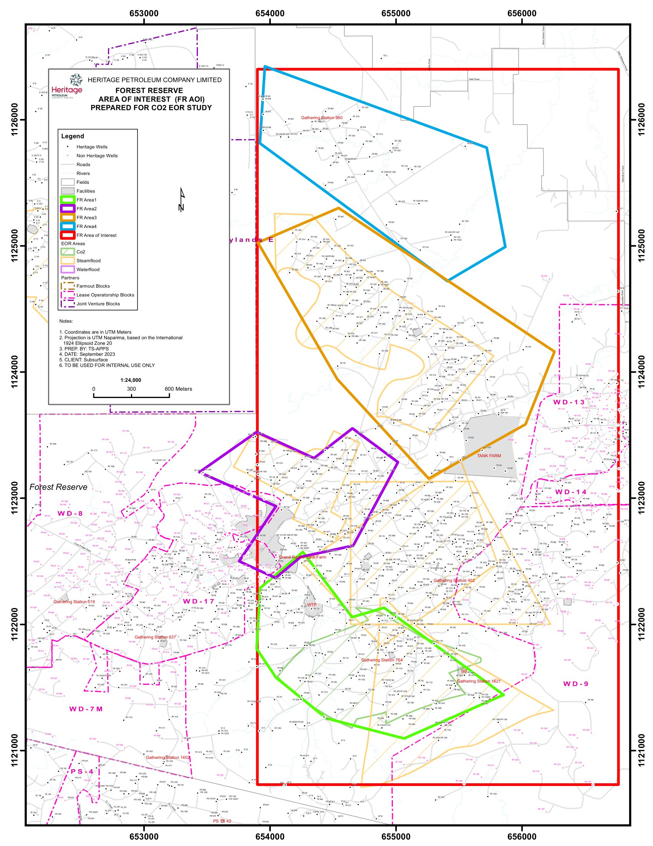
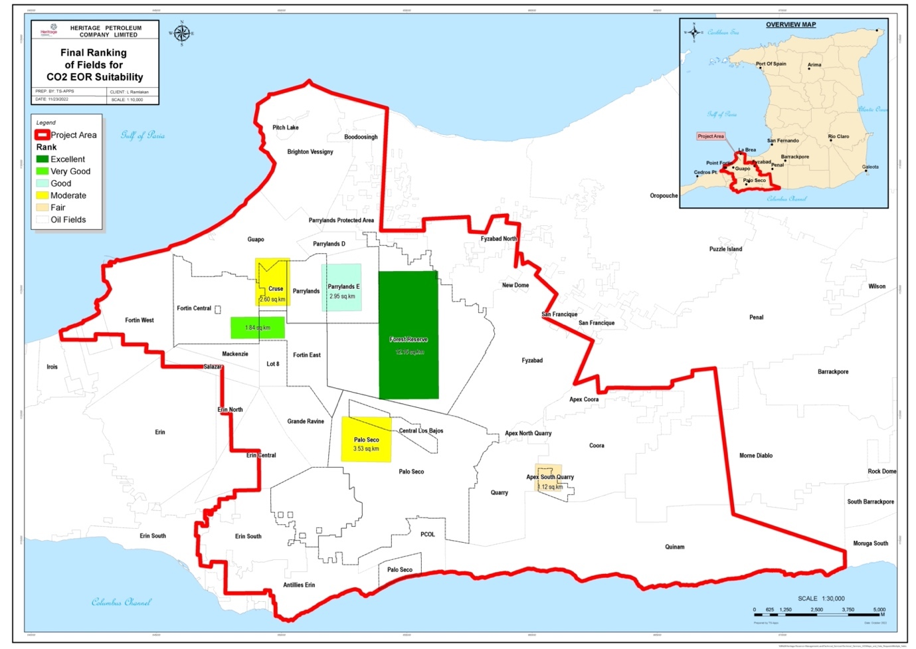
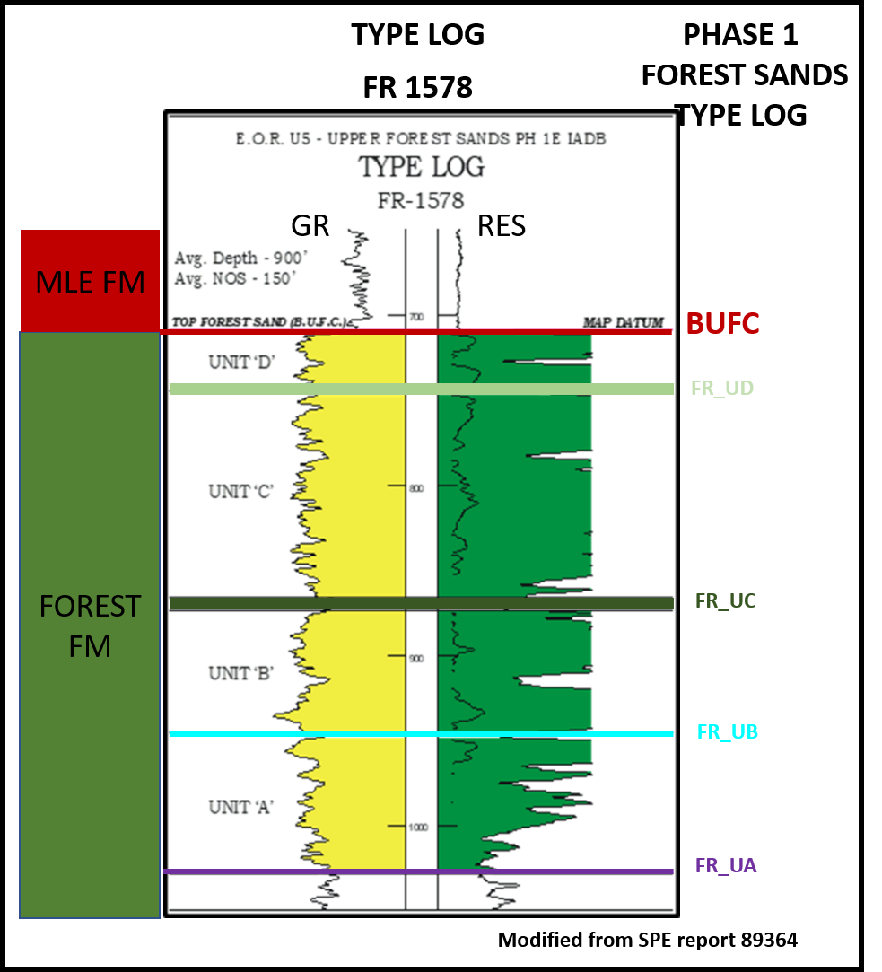
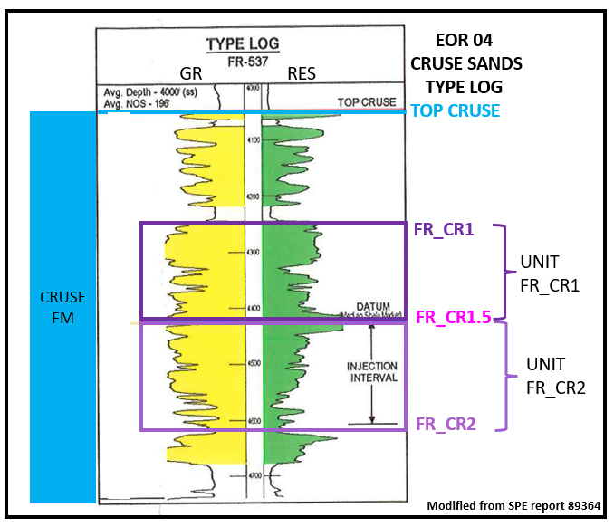
FR AREA 4
(FR1700/ PROJECT 21 – HWF)
RESERVOIRS: Cruse
DEPTH: 2000 ft TVDSS
TOTAL WELLS: 53
ACREAGE: 439 acres / 1.78 km²
FOREST RESERVE AOI ≈ 4000 acres
FR AREA 3
(PROJECT 3- STEAMFLOOD)
RESERVOIR: Forest
DEPTH: 1000ft TVDSS
TOTAL WELLS: 143
ACREAGE: 573 acres / 2.32 km²
FR AREA 2
TYPE LOG
FR AREA 1
TYPE LOG
FR AREA 2
(PHASE 1 EAST AND WEST
STEAMFLOOD/ CO₂ EOR)
RESERVOIR: Forest
DEPTH: 900 ft TVDSS
TOTAL WELLS: 85
ACREAGE: 243 acres/ 1 km²
FR AREA 1
(EOR 04, EOR 33 CO₂)
RESERVOIRS: Forest, Cruse
DEPTH:1500 to 4500 ft TVDSS
TOTAL WELLS: 169
ACREAGE: 359 acres /1.45 km²

Slide 6
Carbon Atlas

Slide 7


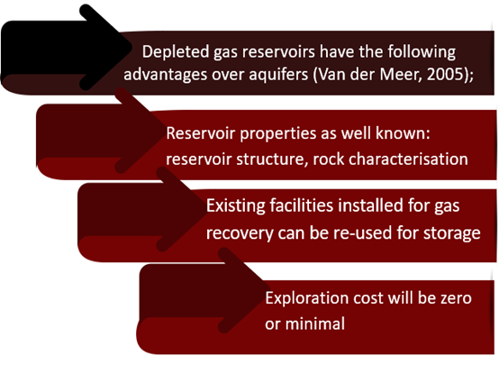
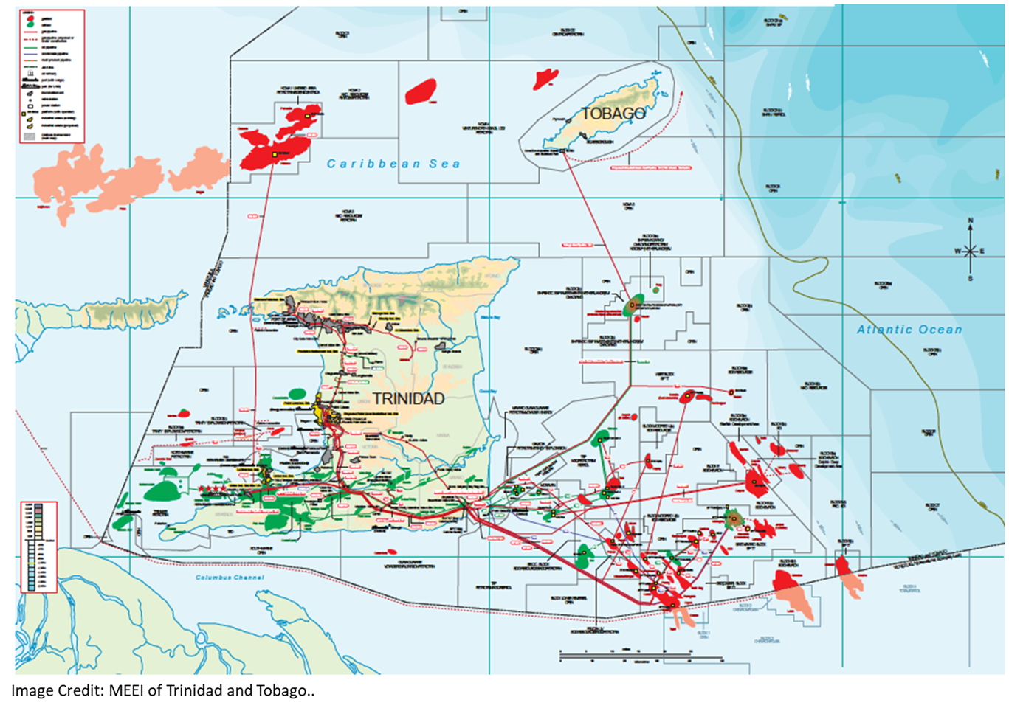
O&G Reservoirs in T&T
UTT and UWI has the responsibility to develop the atlas for the following areas and with Funding Support from MEEI and BPTT: Southern Basin – onshore; UTT - 3 fields and UWI - 2 fields
Southern Basin – offshore; UTT - 5 fields and UWI – 3 Blocks
Northern Basin – offshore; UWI – 3 Blocks
Columbus Basin – UTT – 5 fields and UWI 4 fields

Slide 8
UWI and UTT Carbon Capture Utilisation and Storage Collaborate (CCUS-C)
Formally launched on 01 May 2024
Objectives of the CCUS-C are to provide services in the areas of CCUS and renewable energy to Government, State Agencies, Energy Companies and Academia - locally, regionally and internationally, as follows:
  To provide lectureship, research and supervisory support in areas of CCUS such as - Policy, Legal, Technical and Regulatory, Public Awareness, including Geoscience; Well and Reservoir Engineering, Hydrogen and Geothermal Energy and any areas of Renewable Energy.
  Development of short courses and micro-credential programs in CCUS
  Development of a new self-financing MSc program in Carbon and Gas Management.
  To develop and provide support to Project Proposals and reports for CCUS including Direct Air Capture, Blue and Green Hydrogen, green methanol and green ammonia.
  To provide Training on Green House Gas Accounting.
  To provide Training in various software for CCUS applications.
  To Conduct Applied Research, Advisory & Consulting Services such as Experimental and Simulation Studies for CCS in depleted oil and Gas Reservoirs and saline aquifers.
  Continue to establish local and global partnerships in CCUS.
  To provide services to the Energy Industries and Government and respond to specific requests from stakeholders.
  To establish a working group with all stakeholders and develop a proposal for obtaining funding support and implementation of a CCUS Field Demonstration Project in Trinidad and Tobago.

Slide 9
Legal and Regulatory

Slide 10

Elements of Draft Policy to create Capture and storage legislation
Policy Context – Paris Agreement, T&T’s NDC goals
Proposed Process for CCUS Projects
  Competitive Bidding Process for exploration licence
  Granting of Storage Permit to exploration licensees (storage) or O&G E&P, PSC licensees
  Sale/ Purchase of CO2 to/from NGC Green for transportation & marketing
  Establishment of a Project Fund for Long Term Monitoring & Remediation
  Decommissioning Program
  Transfer of Liability post closure to the State
Drafting Instructions - includes definitions and outline of Legislation
Requirements to Bring New Legislation Onstream
  Amendment to other Legislation – Green Fund regulations, EM Act

Slide 11
Timeline of the CCUS policy & Final guidelines creation
  Research on international CCUS laws
  1st Draft Policy created
Feedback requested from 24 stakeholders on Draft CCUS Policy
Robust feedback received from 14 stakeholders
  Draft Policy amended based on feedback
  Guidelines drafted
2nd Draft Policy Consultation start with 32 stakeholders
Feb-Jul 2022
Aug 2022
Jan 2023
Feb – Nov 2023
Dec 2023
2nd Draft Collate Stakeholders
Responses
2nd Draft Policy
Final for Cabinet
Final Policy
Cabinet Approval and Policy Granted
Chief Parliamentary Council Bill Drafting
April 2024
May 2024
July 2024
July 2025

Slide 12
Initial feedback on 2nd draft of policy – work in progress
Policy sections missing – e.g. compliance and enforcement
Aggregator model – consider other models Canada, EU, Australia
Clarity on tax incentives (6.2)
Decommissioning 8.2 (x), (xi)
Definitions
Operator vs aggregator vs emitters revenue generation
Funding – EU model
Reporting requirements

Slide 13
Funding

Slide 14
Terms of Reference
Commercial Business Model Development
Contractual structuring, strategy
Project Financing Mechanism
Government Support : Fiscal, Financial grants etc.,
Development of Carbon Pricing, Carbon Trading Policy and participation in Carbon Markets
Project Economics for CO2 EOR and Pure Carbon Sequestration
Participate in Commercial Negotiations

Slide 15
Thank you

Slide 16
Back up

Slide 17
Collaboration with Heritage and UWI/UTT
The CO₂ EOR Subsurface Workgroup has been integrating and assuring identified areas with Heritage. Focus is currently on Forest Reserve Field.
Ongoing Assurance is taking place with Geological model planned to be completed by end June 2024
    Looking at different seismic volumes
    Correlations, flow units
    Petrophysics
    Integration with reservoir engineering and production data
    Identify containers
  Work with UWI/UTT to generate model with match to former EOR pattern performance, iterate .
    Progress the Reservoir Modeling to end July 2024

Slide 18
Carbon Atlas : Collaboration with UWI/UTT and Industry
Project Justification
The Development of a Carbon Storage Atlas will represent a significant step towards a low carbon and eventual net zero future for T&T.
It will form the foundation for significant reduction of T&T’s carbon footprint.
Project Objectives
To Identify potential geological CO₂ storage sites in depleted oil and gas reservoirs offshore and onshore Trinidad and Tobago.
A first CCS in the Caribbean region.

Slide 19
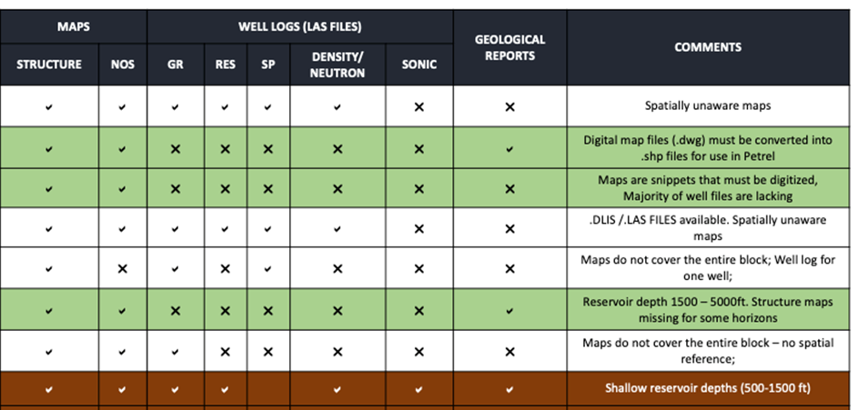
Challenges: Data Gathering / Screening
Data quality; Data quantity; Rate of data collection; Funding

Slide 20
Legal/Regulatory : Draft policy subsidiary guidelines/regulations
Geological Carbon Storage Project Guidelines
Intended to guide Storage Permit project submissions
Disposal & Injection Well Guidelines
To guide well by well submissions such as drilling and workovers
Applies to the well, subsurface & to surface equipment
Emissions quantification, reservoir description, well integrity, monitoring & economics covered
Post approval reporting defined
Main considerations are casing, tubing and cementing integrity
Not limited to Carbon Storage Projects

