Slide 1
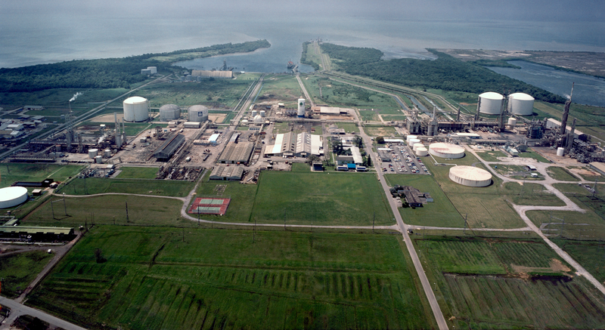
cARBON CAPTURE, UTILISATION & STORAGE Policy, legal, legislation Penelope Bradshaw –Niles Permanent Secretary, Ministry of Energy and Energy Industries
Government of the Republic of Trinidad and Tobago
Ministry of Energy and Energy Industries
TOWARDS A NET-ZERO CARBON FUTURE WITH CCS
AN INTERNATIONAL SYMPOSIUM BY UWI/UTT CCUS COLLABORATE
TRINIDAD AND TOBAGO, SEPTEMBER 6, 2024
Juniper Platform
Source : bp

Slide 2
Carbon Capture & CO2 EOR Steering Committee Organization (CCEOR SC)
Carbon Capture & CO2 EOR Steering Committee
Steering Committee Coordinator
Technical/Subsurface Workgroup
UWI/UTT Carbon Storage Atlas Workgroup
GHG/Methane Emissions Workgroup
Legal/Regulatory Workgroup
Funding / Commercial Workgroup

Slide 3
Timeline of the CCS draft policy & guidelines creation
Feb-Jul 2022
Research on international CCS laws
1st Draft Policy created
Aug 2022
Feedback requested from 24 stakeholders on Draft CCS Policy
Jan 2023
Robust feedback received from 14 stakeholders
Feb – Nov 2023
Draft Policy amended based on feedback
Dec 2023
2nd Draft Policy Consultation start with 32 stakeholders
Guidelines drafted

Slide 4
Main Elements of Draft Policy
Proposed Process for CCS Projects
Policy Context – Paris Agreement, T&T’s NDC goals
Proposed Process for CCS Projects
Drafting Instructions - includes definitions and outline of Legislation
Requirements to Bring New Legislation Onstream
Amendments to other Legislation – Green Fund regulations, EM Act
Competitive Bidding Process for exploration licence
Granting of Storage Permit to exploration licensees (storage) or O&G E&P, PSC licensees
Sale/ Purchase of CO2 to/from NGC Green for transportation & marketing
Establishment of a Project Fund for Long Term Monitoring & Remediation
Decommissioning Program
Transfer of Liability post closure to the State

Slide 5
Draft policy subsidiary guidelines/regulations
POLICY TO CREATE CCS LEGISLATION
GEOLOGICAL CARBON STORAGE PROJECT GUIDELINES
DISPOSAL & INJECTION WELL GUIDELINES
Geological Carbon Storage Project Guidelines
Intended to guide Storage Permit project submissions
Disposal & Injection Well Guidelines
To guide well by well submissions such as drilling and workovers
Applies to the well, subsurface & to surface equipment
Emissions quantification, reservoir description, well integrity, monitoring & economics covered
Post approval reporting defined
Main considerations are casing, tubing and cementing integrity
Not limited to Carbon Storage Projects

Slide 6
Amendments between draft policies
1st Draft
(Aug 2022)
CO₂ EOR ROLE UNCLEAR
AWARD CRITERIA FOR EXPLORATION LICENCES UNDEFINED
2nd Draft
(Dec 2023)
AGGREGATOR RECOMMENDED TO TRANSPORT & MARKET CO₂
CO₂ EOR ROLE CLARIFIED
COMPETITIVE BIDDING PROCESS FOR EXPLORATON LICENCES
NO CO₂ AGGREGATOR PROPOSED
POST CLOSURE LIABILITIES SPLIT BETWEEN STATE & LICENSEE
POST CLOSURE LIABILITIES ABSORBED BY STATE
NO PROVISIONS FOR STATE FUNDING
GREEN FUND AMENDMENT TO TARGET CO₂ STORAGE PROJECTS
SIMULTANEOUS CO₂ STORAGE & O&G EXTRACTION OPERATIONS NOT ADDRESSED
SIMULTANEOUS STORAGE & EXTRACTION OPERATIONS PROTOCOL INCLUDED

Slide 7
Feedback from draft policy 2nd stakeholder consultation

Slide 8
Clause 6.2 - Obtaining Approval for CCS project
Existing Policy Clause:
Feedback on Clause:
This clause outlines the approval process for the CCS project, from the application for an exploration licence to the transfer of ownership and obligations under a storage permit from the Operator to the Government. Feedback on Clause 6.2 highlighted the need for:
More detailed steps in the application process;
Inclusion of a time frame for the exploration licence and storage permit;
Clarification of stakeholder roles and responsibilities;
Criteria for approval of licences and permits; and
Process for appeals or disputes if applications are denied

Slide 9
Clause 6.3 – Establishment of a Fund
Existing Policy Clause
Feedback on Clause:
Clause 6.3 provides for the establishment of a per project fund financed by the Operator but controlled and administered by the Minister for remedial works and on-going monitoring of the CCS storage site post-decommissioning.
A cost matrix for contributions to the fund;
Details on the establishment, monitoring, maintenance and enforcement of the fund;
Clarification on the scope of a “project”;
Clarification on whether the fund will cover costs post-transfer exclusively or post-decommissioning and post-transfer; and
Information on fund recoupment in case of leakage, non-compliance or technological changes.

Slide 10
Clause 6.4 – Decommissioning Programme
Feedback on Clause
Existing Policy Clause
This clause sets out the requirement for the Operator to submit a decommissioning plan detailing all the installed equipment, infrastructure and materials, along with decommissioning solutions for each and safety measures to decommission disused installations and pipelines. Stakeholder feedback on this clause included requests for:
Commencement date for decommissioning programme during the project’s lifespan;
Inclusion of short, medium and long-term monitoring plan in the decommissioning programme;
Clarification on the requirements for decommissioning;
Clarification on the MEEI’s capacity to carry out long-term monitoring post-transfer of the storage site.

Slide 11
Clause 6.5 – Transfer of ownership
This clause focuses on ownership and liability matters post-cessation of operations at the storage site. It outlines the procedure for transferring responsibility for the storage site from the Operator to the Government following the cessation of operations. Stakeholder feedback on this clause included requests for:
Express statement that ownership for decommissioned facilities transfers to the Government upon issuance of a closure certificate;
The policy to state the conditions for the transfer of ownership;
Identification of the roles and responsibilities of the State post-decommissioning and post-transfer; and
Clarification on how liability would be quantified in the long-term.

Slide 12
Clause 7 – Process Outline – CCS Project Flow Chart
Existing Policy Clause
Feedback on Clause
This clause provides a brief overview of the process for the carbon capture project. Stakeholder feedback on this clause included requests for:.
Introductory text;
Inclusion of decision/process steps where rework or denial of applications occur;
Inclusion of steps for funding by the Operator and application for a closure certificate.

Slide 13
Clause 8.2 – Drafting instructions and definitions
Clause 8.2 guides the drafter for the CCS legislation on the required provisions to be included in the legislation, as well as, the rationale, context and legal considerations for these provisions.
Stakeholder feedback on this clause included emphasis on the need for additional definitions such as carbon emitter, operator, aggregator, storage complex, storage facility, storage site and corrective measures.

Slide 14
Lookahead for ccs draft policy & guidelines creation

Slide 15
Summary feedback and Comparisons to international policy
Policy Element | International Jurisdiction References | 2nd Round Stakeholder Feedback
State Entity aggregator | CO2 Transport & Storage Company of UK CCS Policy Framework. | Broad acceptance but more definition of value chain roles needed. One stakeholder believes aggregator introduces too much complexity
Eligible Storage Site Designation | Australia Offshore Petroleum & GHG Storage Act 2006 | Criteria for approval of licences and permits, storage permit timeframe
Per project Decommissioning Fund | Canada CCS Statute Amendment (2010), EU Directive (2009), UK Energy Act (2008) | Include decommissioning requirements, programme submission timeline, fund contribution timeline.
Transfer of Obligations to State | UK Energy Bill (2022), EU 2009/31 CCS Directive, Australia State of Victoria GHG Sequestration Act (2008) | Welcome provision. Conditions for state transfer needed in Policy. Clearer and more expansive acceptance statement needed.

Slide 16
International CCS policy trends
Government acceptance of Long Term Liability – occurs where the storage operator bears the risk of short term liability during operation and for a specified post closure period but Government accepts liability subject to certain conditions. Eg. Australia, Canada, UK.
Support for CCS Hub development – takes CO2 from several large industrial emitting sources, transports and stores it using common infrastructure. Examples: Northern Lights (Norway), Teeside (UK), Porthos (Netherlands), CENLA (Louisiana).
Government Financing – significant financial resources through loans, guarantees or grants being awarded to CCS projects, infrastructure. Eg. 45Q tax credit (US), Innovation Fund (EU)
Regulation of CO2 Storage – Transparent regulation of access to pore space for Geological Storage eg. GHG Injection licence (Australia), Underground Injection Control permit (US)

Slide 17
ThANK YOU

