Slide 1
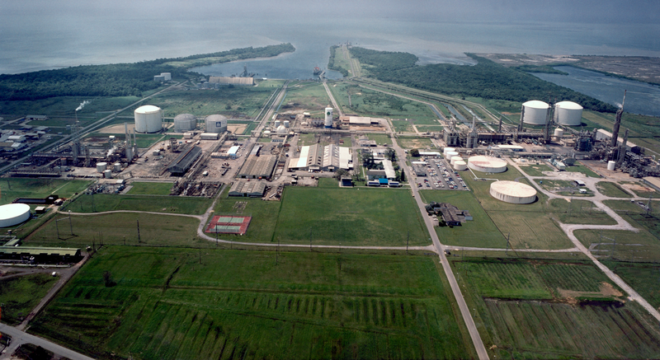
cARBON CAPTURE, UTILISATION & STORAGE A Trinidad & Tobago update 2025 Penelope Bradshaw –Niles Permanent Secretary, Ministry of Energy and Energy Industries
Government of the Republic of Trinidad and Tobago
Ministry of Energy and Energy Industries
TRINIDAD & TOBAGO ENERGY CONFERENCE
FEBRUARY 10-12, 2025
Juniper Platform
Source : bp

Slide 2
Carbon Capture & CO2 EOR Steering Committee Organization (CCEOR SC)
Carbon Capture & CO2 EOR Steering Committee
Steering Committee Coordinator
Technical/Subsurface Workgroup
UWI/UTT Carbon Storage Atlas Workgroup
GHG/Methane Emissions Workgroup
Legal/Regulatory Workgroup
Funding / Commercial Workgroup

Slide 3
Timeline of the CCS draft policy & guidelines creation
Feb-Aug 2022
Research on international CCS laws
1st Draft Policy created
Jan – Nov 2023
Robust feedback received from 14 stakeholders
2nd Draft Policy Consultation with 32 stakeholders
Feedback requested from 24 stakeholder
Draft Policy amended based on feedback
Guidelines drafted
Dec 2023 – Jan 2025
Policy amended & expanded based on feedback

Slide 4
Main Elements of Draft Policy
Proposed Process for CCS Projects
Policy Context – Paris Agreement, T&T’s NDC goals
Proposed Process for CCS Projects
Drafting Instructions - includes definitions and outline of Legislation
Requirements to Bring New Legislation Onstream
Amendments to other Legislation – Green Fund regulations, EM Act
Competitive Bidding Process for exploration licence
Granting of Storage Permit to exploration licensees (storage) or O&G E&P, PSC licensees
Sale/ Purchase of CO2 to/from NGC Green for transportation & marketing
Establishment of a Project Fund for Long Term Monitoring & Remediation
Decommissioning Program
Transfer of Liability post closure to the State

Slide 5
Feedback from draft policy 2nd stakeholder consultation
Notes:
In 2024

Slide 6
Summary feedback and Comparisons to international policy
Policy Element | International Jurisdiction References | 2nd Round Stakeholder Feedback
State Entity aggregator | CO2 Transport & Storage Company of UK CCS Policy Framework. | Broad acceptance but more definition of value chain roles needed. One stakeholder believes aggregator introduces too much complexity
Eligible Storage Site Designation | Australia Offshore Petroleum & GHG Storage Act 2006 | Criteria for approval of licences and permits, storage permit timeframe
Per project Decommissioning Fund | Canada CCS Statute Amendment (2010), EU Directive (2009), UK Energy Act (2008) | Include decommissioning requirements, programme submission timeline, fund contribution timeline.
Transfer of Obligations to State | UK Energy Bill (2022), EU 2009/31 CCS Directive, Australia State of Victoria GHG Sequestration Act (2008) | Welcome provision. Conditions for state transfer needed in Policy. Clearer and more expansive acceptance statement needed.

Slide 7
Amendments between draft policies
1st Draft
(Aug 2022)
CO₂ EOR ROLE UNCLEAR
AWARD CRITERIA FOR EXPLORATION LICENCES UNDEFINED
2nd Draft
(Dec 2023)
AGGREGATOR RECOMMENDED TO TRANSPORT & MARKET CO₂
CO₂ EOR ROLE CLARIFIED
COMPETITIVE BIDDING PROCESS FOR EXPLORATON LICENCES
NO CO₂ AGGREGATOR PROPOSED
POST CLOSURE LIABILITIES SPLIT BETWEEN STATE & LICENSEE
POST CLOSURE LIABILITIES ABSORBED BY STATE
NO PROVISIONS FOR STATE FUNDING
GREEN FUND AMENDMENT TO TARGET CO₂ STORAGE PROJECTS
SIMULTANEOUS CO₂ STORAGE & O&G EXTRACTION OPERATIONS NOT ADDRESSED
SIMULTANEOUS STORAGE & EXTRACTION OPERATIONS PROTOCOL INCLUDED
Final Draft (Jan 2025)
GREATLY EXPANDED THE DRAFTING INSTRUCTIONS DEFINITIONS TO CLARIFY TECHNICAL, & CONTRACT TERMS
INCLUSION OF TERMS AND CONDITIONS FOR EXPLORATION LICENCE, STORAGE PERMIT AND DECOMMISSIONING ACTIVITIES
Inclusion of a time frame for the exploration licence, decommissioning programme submission & transfer of ownership
COMPREHENSIVE AND EXPANDED PROCESS OUTLINE FOR A CCS PROJECT
Comprehensive statement of Government’s acceptance of liability post closure & conditions for the transfer.

Slide 8
Lookahead for ccs draft policy & guidelines creation
Cabinet approval of Draft Policy expected by end of 1st Quarter 2025
Referral of Policy to Chief Parliamentary Council (CPC) in the AG’s office for Bill Drafting.
Workgroup to provide assistance to CPC over at least a one year period.

Slide 9
Carbon Capture & CO2 EOR Steering Committee Organization (CCEOR SC)
Carbon Capture & CO2 EOR Steering Committee
Steering Committee Coordinator
Technical/Subsurface Workgroup
UWI/UTT Carbon Storage Atlas Workgroup
GHG/Methane Emissions Workgroup
Legal/Regulatory Workgroup
Funding / Commercial Workgroup

Slide 10
Terms of reference
1. Develop Commercial/Business model development for
Carbon Capture and Storage
Carbon Capture and CO2 EOR
2. Develop Contractual structuring, strategy and map
3. Survey Project Financing Mechanisms
4. Recommend Governmental Support
5. Develop Carbon Pricing, Carbon Trading Policy and participation in Carbon Markets (primarily lead by Min. of Planning)
6. Demonstrate Project Economics for CO2 EOR and pure Carbon Sequestration
7. Assist in commercial negotiations – as project develops

Slide 11
Workgroup Membership
Ministry of Energy and Energy Industries
Resource Management Division
Commercial Evaluation Division
Legal Services Unit
Ministry of Planning and Development
Environmental Policy and Planning Division
Ministry of Finance:
Economic Management Division
Inland Revenue Division
University of the Trinidad and Tobago
Petroleum Engineering Unit
Climate Analytics

Slide 12
Milestones
Mar 2024 – First workgroup meeting
- Financing sources review
Jul 2024 – Budget 2025 recommendations submitted to Min. of Finance
Aug 2024 – Ministry of Finance nominees joined
Sept 2024 – Meeting with Energy Chamber on Carbon Levy proposal,
- CCS Business Model Review
Jan 2025 – Review of CO2 EOR Model

Slide 13
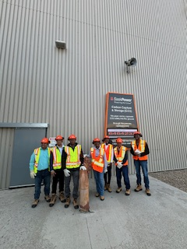
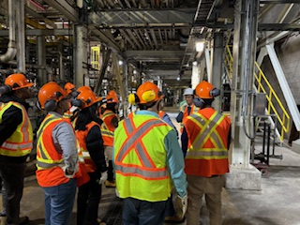
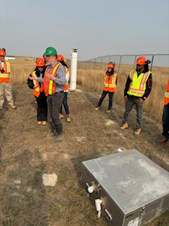
MEEI visits the boundary dam capture Facility and dedicated saline storage site in regina, Saskatchewan.

Slide 14
Meei visit to regina, and Calgary, alberta
CCUS centre of Excellence meeting.
attended the IEAGHG ExCo66 members meeting in Calgary.
Toured a CO2 lab at the University of Calgary.
Notes:
CCS Knowledge Centre at Regina – having a CCS Knowledge Centre:
Can lead on understanding the national potential
Can lead on capacity building
Can help seek international climate funding, e.g. ADB, World Bank, GCF,
International carbon markets (Paris Agreement Article 6)
Can help develop regulations
To inform government, advise on CCUS in climate policy, including NDC
updates – be a national resource of expertise

Slide 15
ThANK YOU

